Slide 2

Dan
MacLean
Notes:
I like to introduce myself
My name is Dan

Slide 3
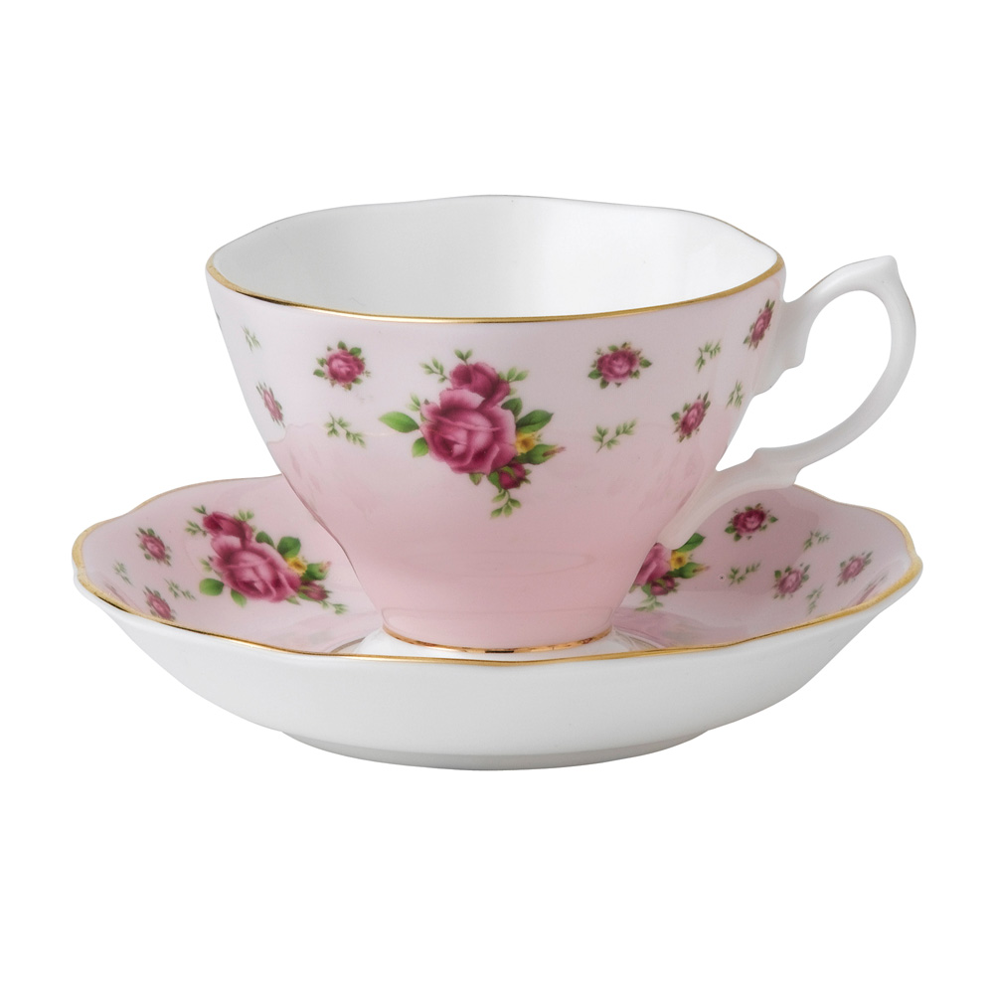
Notes:
And Im from England

Slide 4

Notes:
But Im not this sort of Englishman, Im not the stereotypical sort

Slide 5
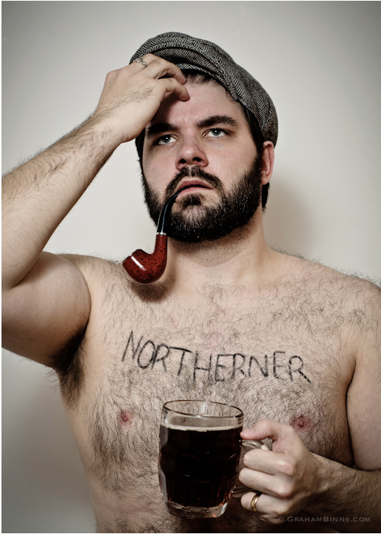
Notes:
Im much more this sort of Englishman. Im from the North of England, Im from Manchester, in fact. And we aren’t the stereotypical sort of Brit. So I hope you won’t find me too stuffy and typically British.

Slide 6
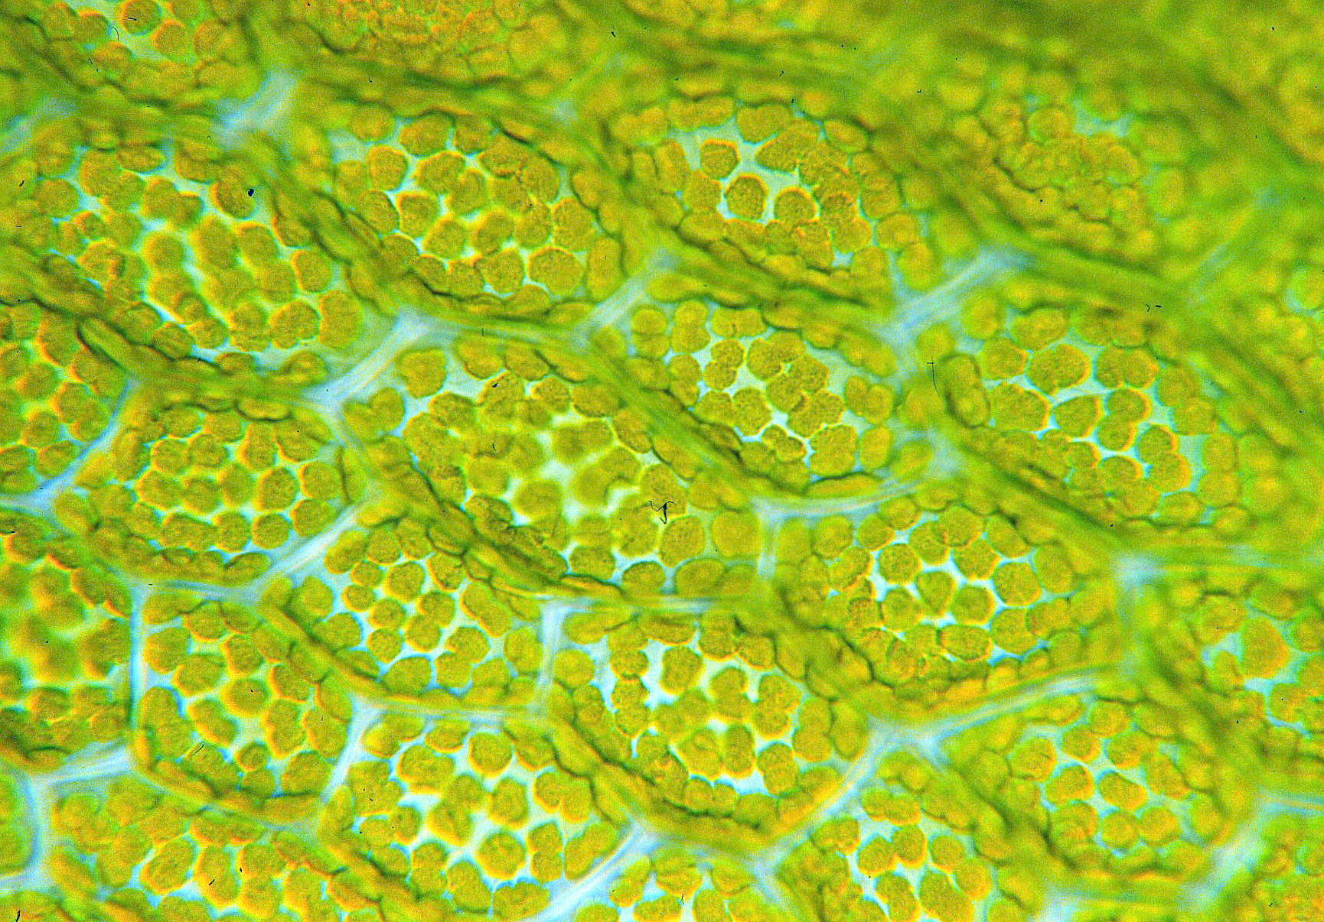
Notes:
I’m also a plant molecular biologist by training, my PhD was mostly at the bench. I studied transcriptional regulation of nuclear genes for plastid proteins for my PhD.

Slide 7
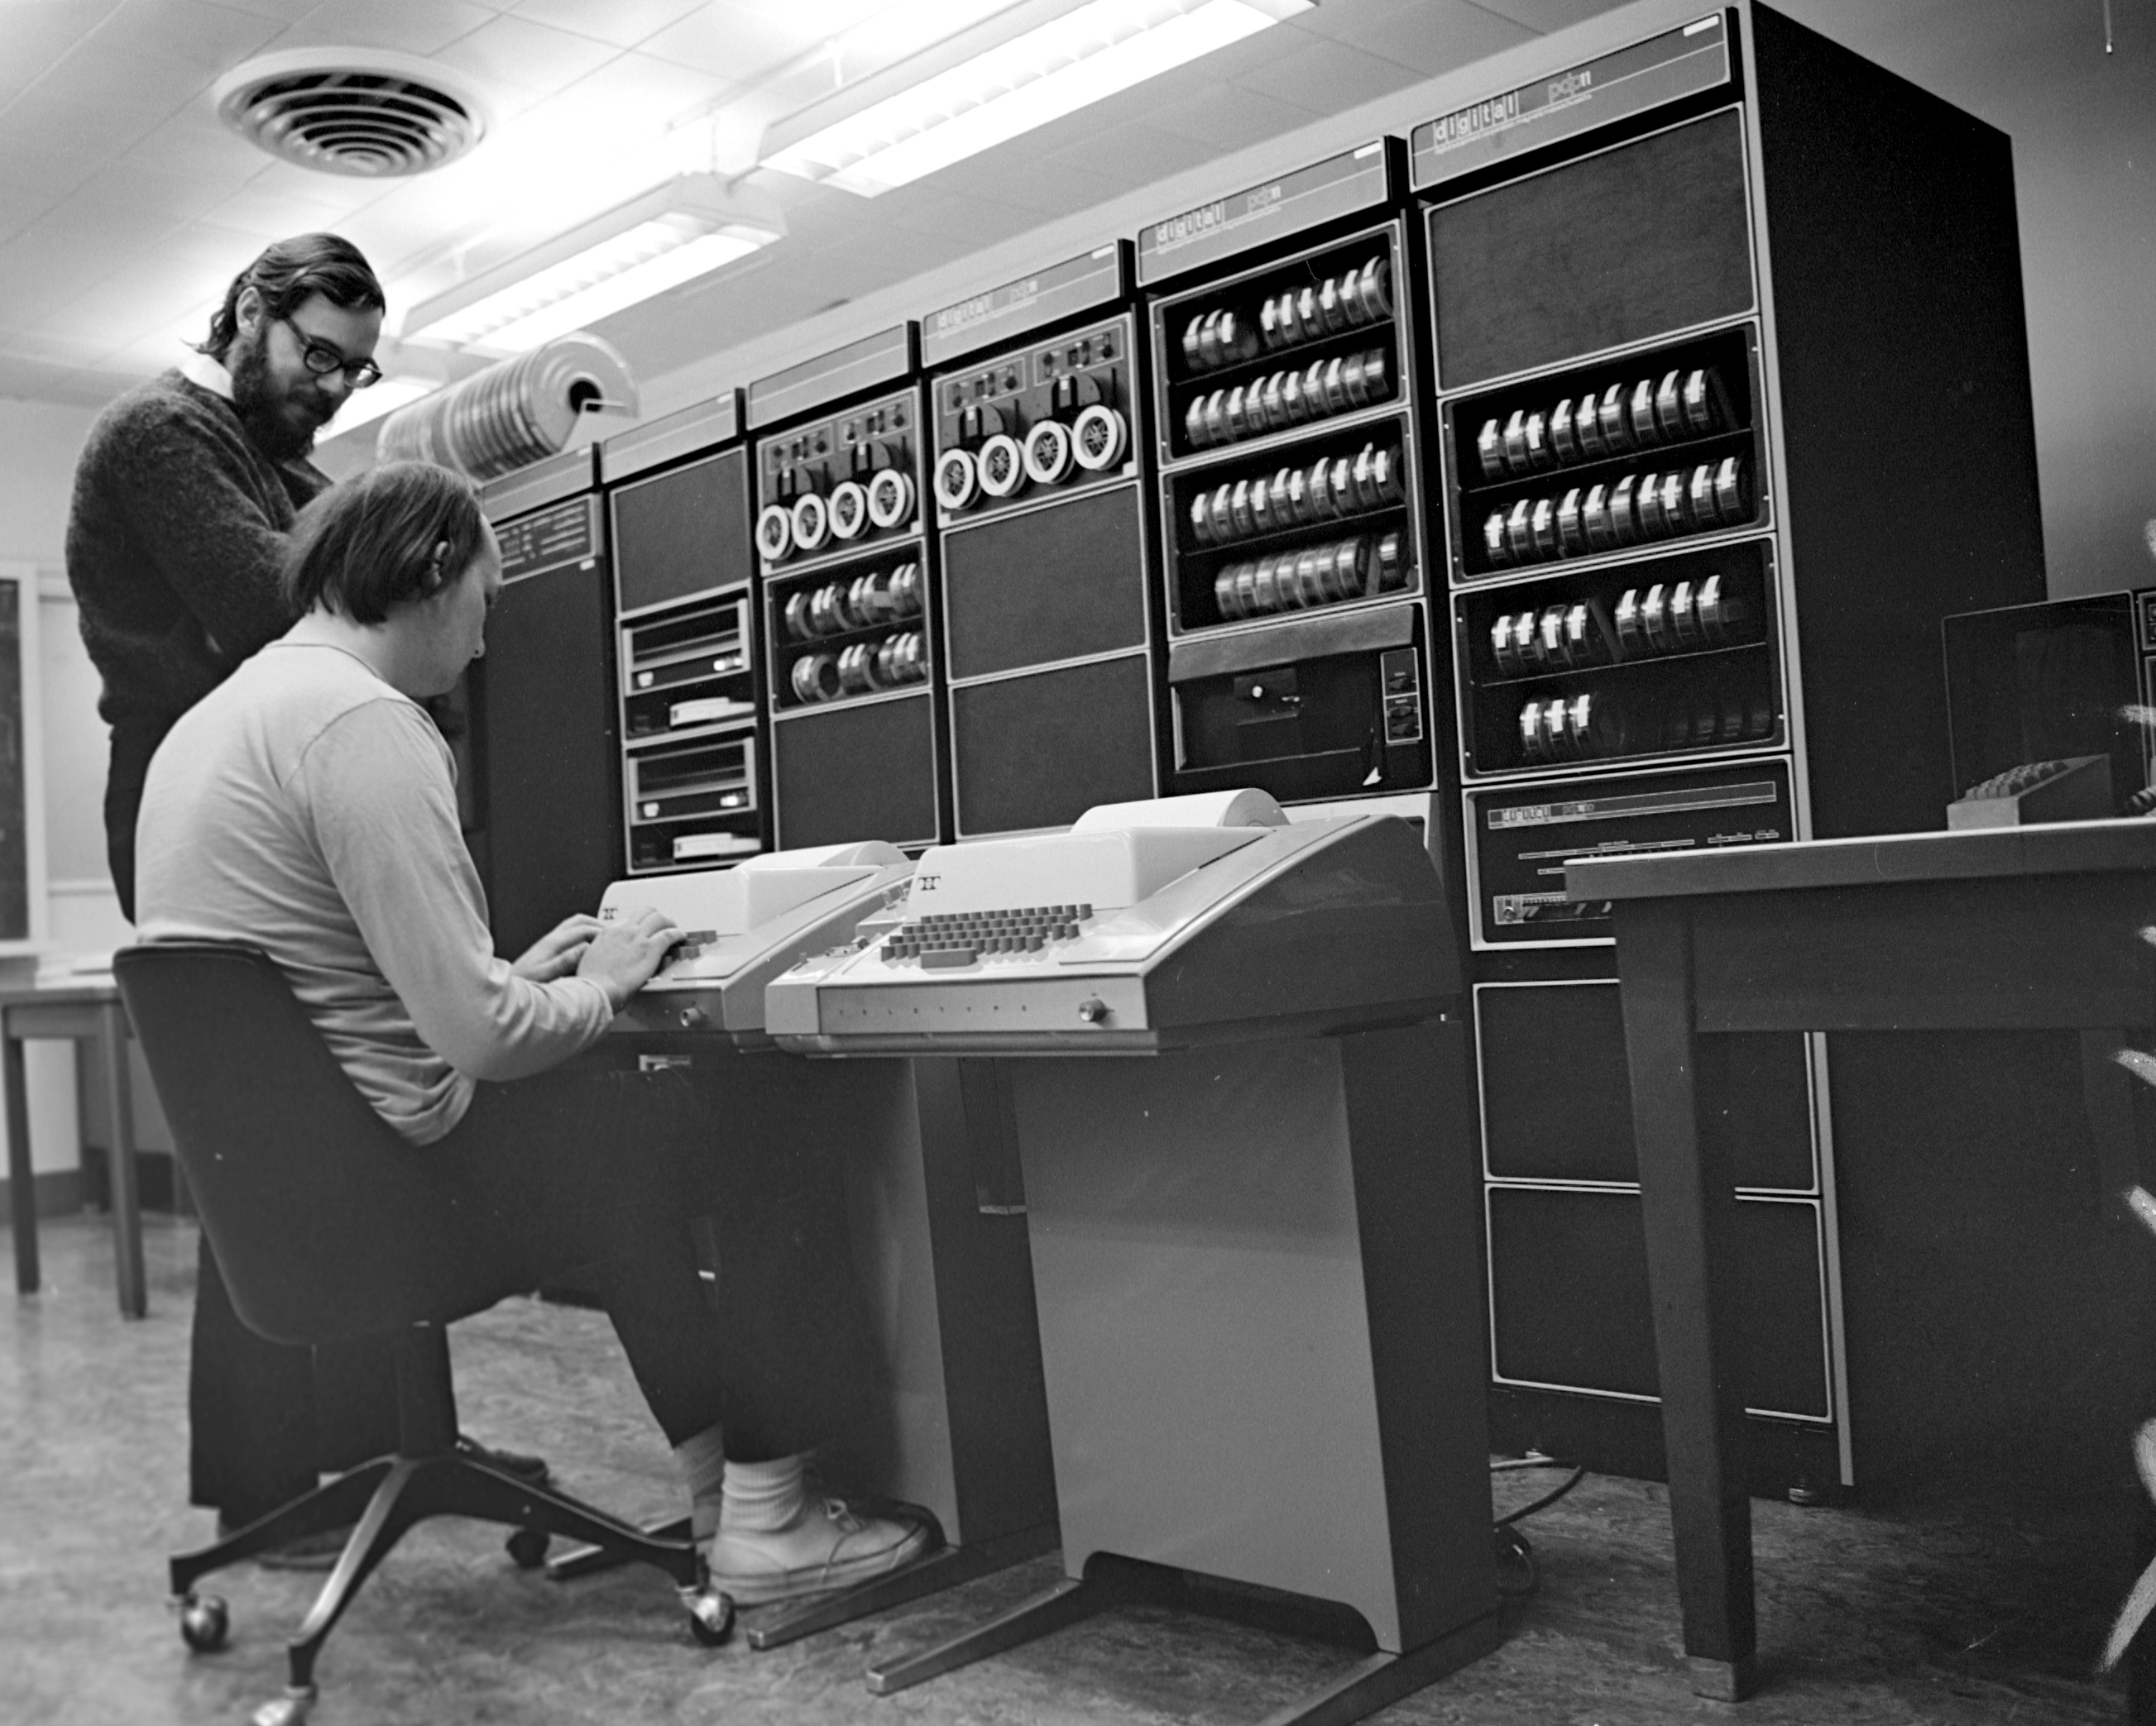
Notes:
But since then, through my later PhD and postdoctoral and subsequent work I’ve worked exclusively at the computer. Im what most people would consider a bioinformatician.

Slide 8

Notes:
I work at the Sainsbury Lab, which is in Norwich in the East of England, and we study plant microbe interactions. In particular pathogen interactions. And we work on basic and translational research in this field.

Slide 9
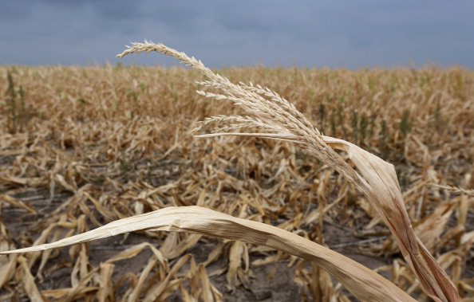
Notes:
And we have something very strong in common with you guys, one of our main research aims is to develop durable resistance to disease in crops. In particular we work on wheat, potato and barley.

Slide 10
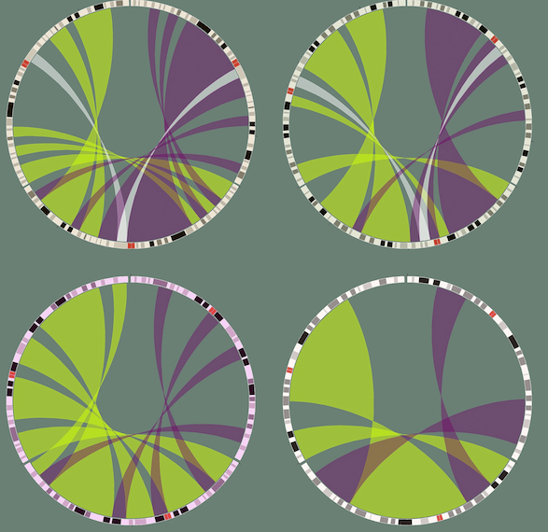
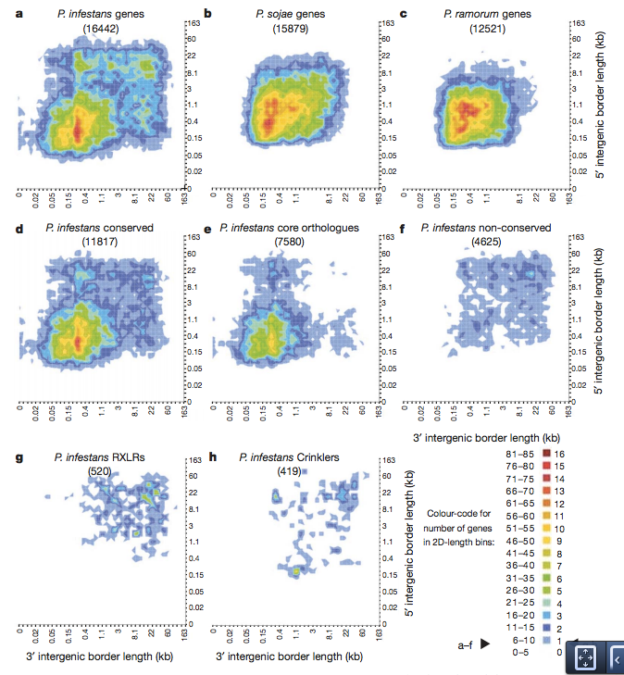
Genomics at TSL
Notes:
So naturally we do an awful lot of genomics and sequencing. We look at things from the plant and pathogen side, so we use sequence data for many reasons
High throughput genome sequencing
De novo assembly
reqsequencing
Effector protein detection
R gene cloning
Genetic variant finding
Annotation
RNAseq ChIPseq Arrays
We have quite a long history of sequencing, we took delivery of our first Solexa sequencing machine in 2006, which I believe was the first in the country outside the Sanger centre. At that time everything was completely in-house, there were no services and no ready to use solutions,
so we had to build our capacity and knowledge from the ground up as we went along and that’s how the bioinformatics team and the work Im going to describe today all came about.

Slide 11
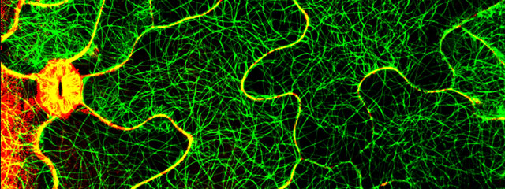
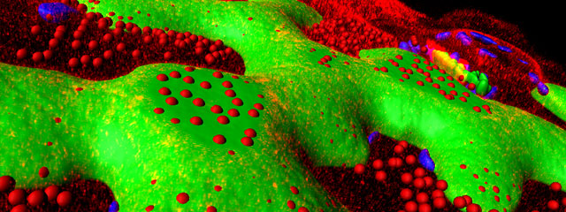
High Content Image Analysis at TSL
Notes:
Subsequently, TSL expanded, and we now have much more than sequence data to deal with. We have high content image analysis machines running and generating complex 3D image files, on which we need to do
Image segmentation
Object detection
Algorithm development
Database integration

Slide 12
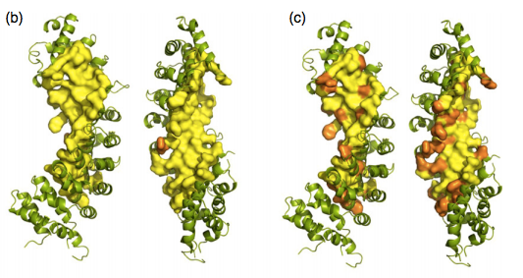
Proteomics at TSL
Notes:
And we have a proteomics team internally, who run their own mass spec and who we collaborate with to do
Pipeline development,
New statistics for spectrum analysis

Slide 13
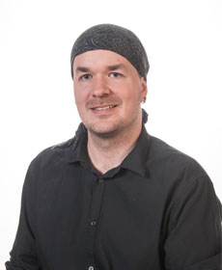
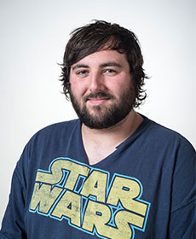
A small core team
For ~ 100 scientists
Dr Christian Schudoma
Mr Martin Page
Notes:
So given these varied data and the large amount of expertise needed for each, you can imagine we’d need a substantial support team.
Well, we don’t have a substantial team, for our 6 groups of about 100 scientists running this stuff fairly non-stop I have a team of 3 including myself.

Slide 14
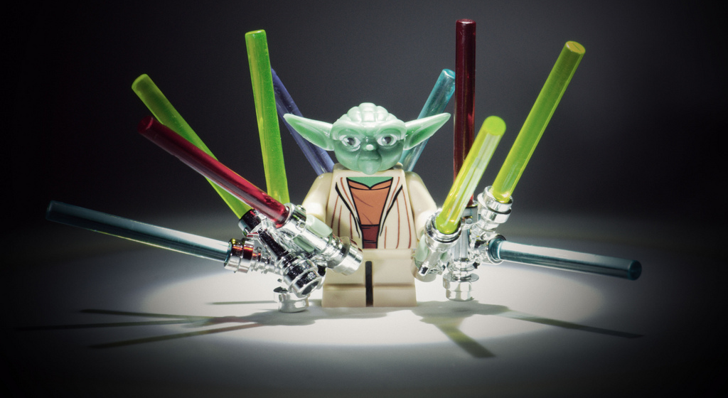
J.E.D.I* approach (Just Enough Developed Infrastructure)
JEDI Bioinformatics
(Just Enough Developed Infrastructure)
Notes:
So given that background I’m going to tell you a story today about how we brought skills and data together to allow us to deal with our own data deluge.
And this is bioinformatics after all, and bioinformatics is flooded with acronyms. So I’ve, half seriously called this the ‘JEDI’ or just enough developed infrastructure approach

Slide 15

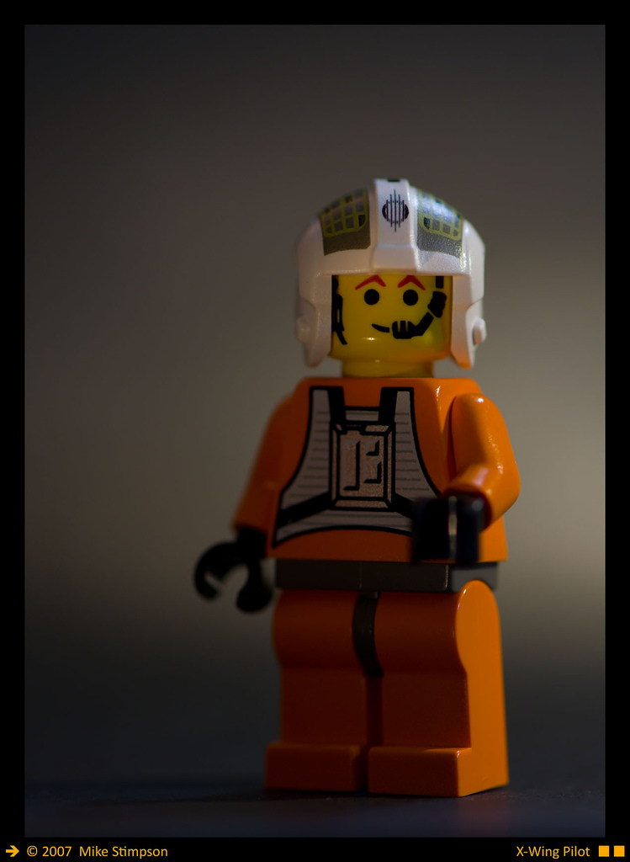
Understand, manage, analyze
Three things in each project
core informatician
project scientist
% ‘get it’
(biological provenance)
Notes:
So I sat down and thought about what the common sequence of events was when I was confronted with a new project and who the parties involved are.
Typically, there was me, the core informatician. And there was the ‘owner’ of the data, the project scientist.
I realized that there are three abstract things I had to do. I first had to understand exactly what the data are. So what it was from, what the experiment was and what the biological significance of it was.
Then I had to manage it properly, get it into analyzable form, look after it for posterity, label it properly etc
And then the work could actually begin and I could get on analysing it.
Each of the parties understand each aspect very differently: The core informatician could never understand the data as well as the person who generated it (particularly as this would only be one of many that they would be working on).
Biologists are typically dreadful at data management and structure,
And each has a different strengths when it comes to analysis, born out of these other two,

Slide 16
Understand, manage, analyze
Three things in each project
core informatician
project scientist
% ‘get it’
(biological provenance)
Notes:
So we have these defecits, and we need to get up to speed with each of them. We need to make at least one side of our team good at each, so that we don’t get the slowdowns that occur as we switch the project over from one party to another.

Slide 17
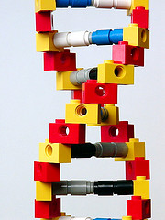
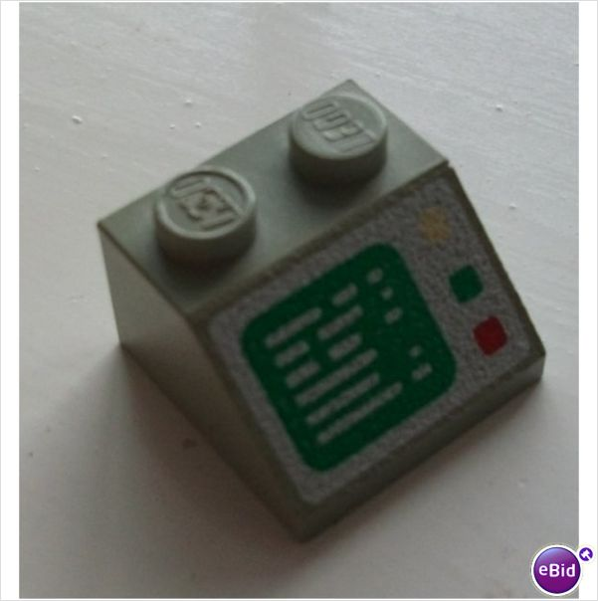

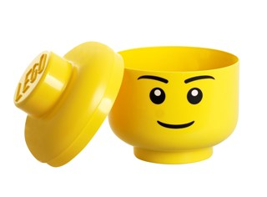
Where to focus?
+
?
+
Notes:
So what do we do? Put all that biology into the informaticians heads? Or put the informatics into the biologists heads?

Slide 18
Where to focus?
Bioinformatics for everyone!
Bioinformatics is a sub-discipline of molecular biology*
+
*Not true everywhere, but for our purposes true enough
Notes:
Well we take the view, that ‘bioinformatics is for everyone!’ and that it is, really, a sub-discipline of molecular biology. So we try and get the informatics skills into the heads of the biologists.
We think this is really the ultimate answer to these issues, that research is always going to need people with the skills to ask and answer the questions themselves. A scientist who doesn’t know how to ask the right questions of their data can’t get the right answers and importantly probably can’t design the right experiments in the first place.

Slide 19
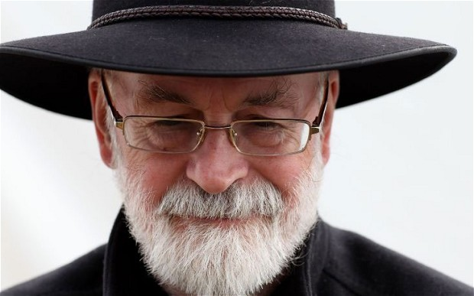
If you build a man a fire, you'll keep him warm for a night.
If you set a man on fire, you'll keep him warm for the rest of his life.
— Terry Pratchett
author of Scheibenwelt (Discworld) novels
Notes:
So to steal from the late but wonderful Sir Terry Pratchett, here’s our ethos…

Slide 20
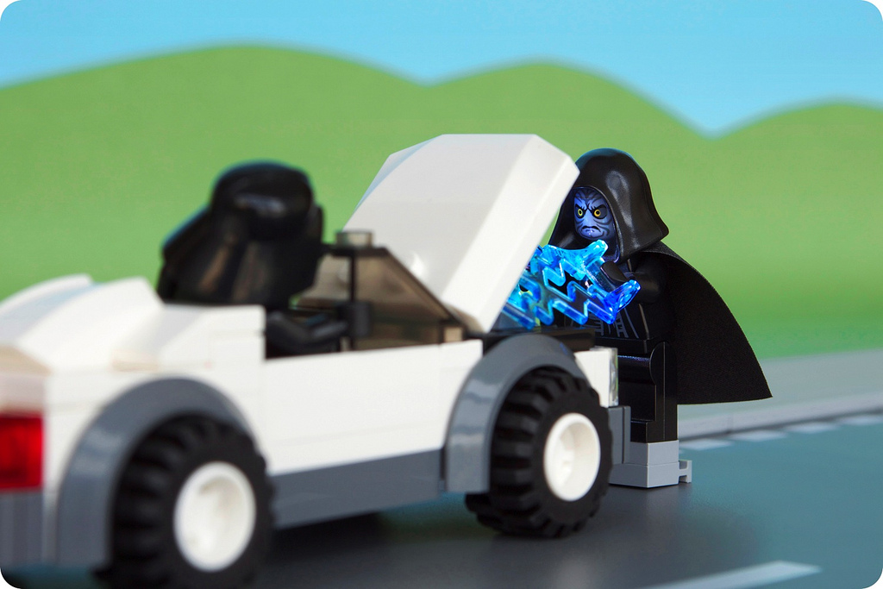
Training
A jump-statrt
Workshops:
Perl, Ruby,
CMD Line,
MySQL,
R + Stats,
Browsers and Desktop tools…
Resource provision:
Workshop notes,
Workshop Podcasts,
Quick ‘How do I’ podcasts
Library
Integration of best practice:
Lab meetings,
Journal Clubs,
Notes:
We set about implementing a training scheme. This was designed to be a jump start into bioinformatics, from the ground up for a novice.
So we built a series of workshops, focusing on introductory topics in the subject, like
Driving the computer through the command line,
Like introductory programming and scripting etc

Slide 21
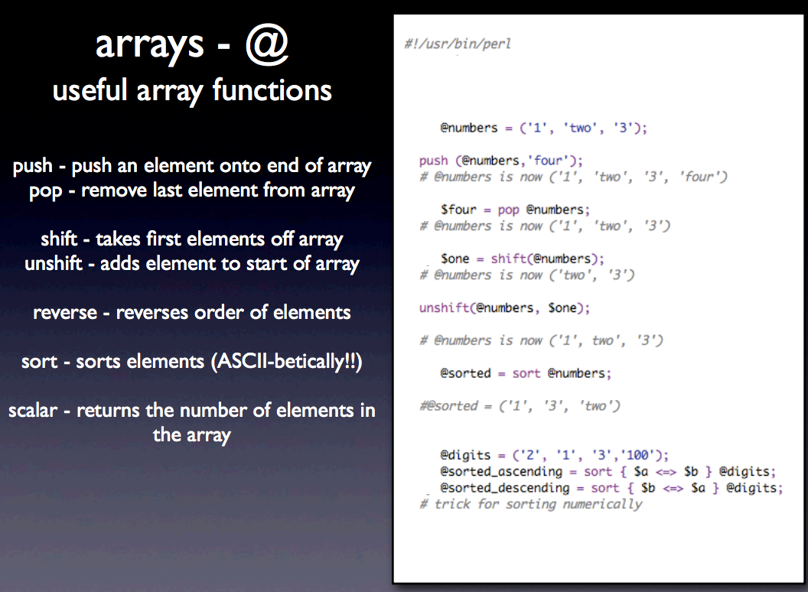
Typical Teaching
Notes:
When we built our training workshops, we took a very naïve approach. We set out and delivered workshops that were essentially lectures, which were supported by slides like this one. It is essentially a list, an instruction manual of commands. And even though our lessons were mixed in with a lot of live practice exercises, the emphasis of the workshop was still very much on the teaching rather than the learning. And that I think was an error we made, I’ll explain more in a few slides.

Slide 22
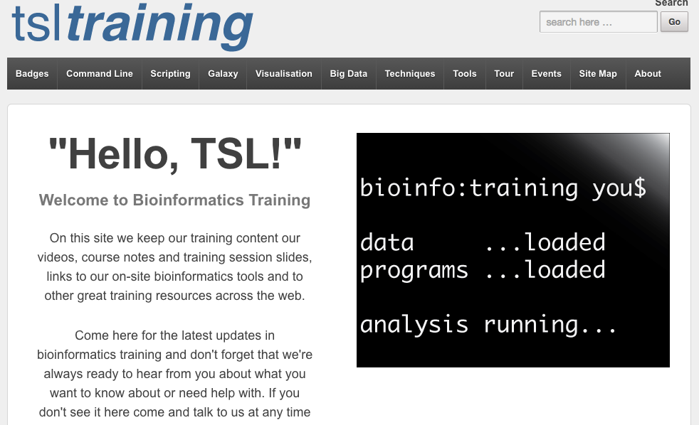
An easy access hub
http://tsltraining.tsl.ac.uk
Notes:
We also strived to make sure our whole set of materials were available at all times. This we did through our training website and we provided a host of other stuff. Our lecture slides, but also videos of the lectures and much shorter quick how-tos.
This allowed independent work on the topics.
This is a public facing site, you’re welcome to go and look at it if you wish.

Slide 23

Training
An open dialogue
Notes:
And although we emphasised the up-front formal side of training we don’t aim to overload anyone with new knowledge before they can even begin. As I said, it’s a jump start. We recognise it takes a long time to be good at any skill so our aim is to provide rolling training, with constant incremental advice and support. We have one killer advantage with this and that is we are on-site. We can interact everyday with our colleagues and try to develop a relationship very similar to the traditional PhD student/ Post Doc one.
We don’t want anyone to feel overwhelmed and hope that in the longer term the work remains an open dialogue with which we can defeat our common foes.

Slide 24
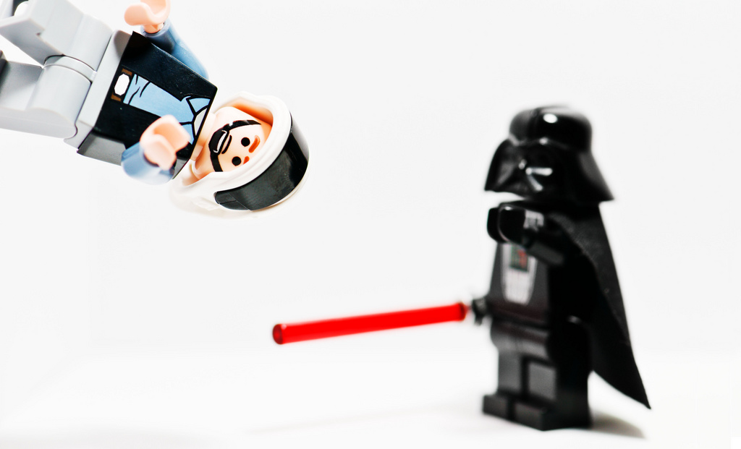
Systems Development
SOP for common tasks – keeping house
helping fight the tyranny of dealing with large data sets
Notes:
For the bioinformatics team though, we had to start work on some stuff behind the scenes. We had to ensure that the environment we were working in together was useful and robust enough for what we wanted to achieve. This meant removing some of the tedious difficulty of dealing with many, large datasets

Slide 25
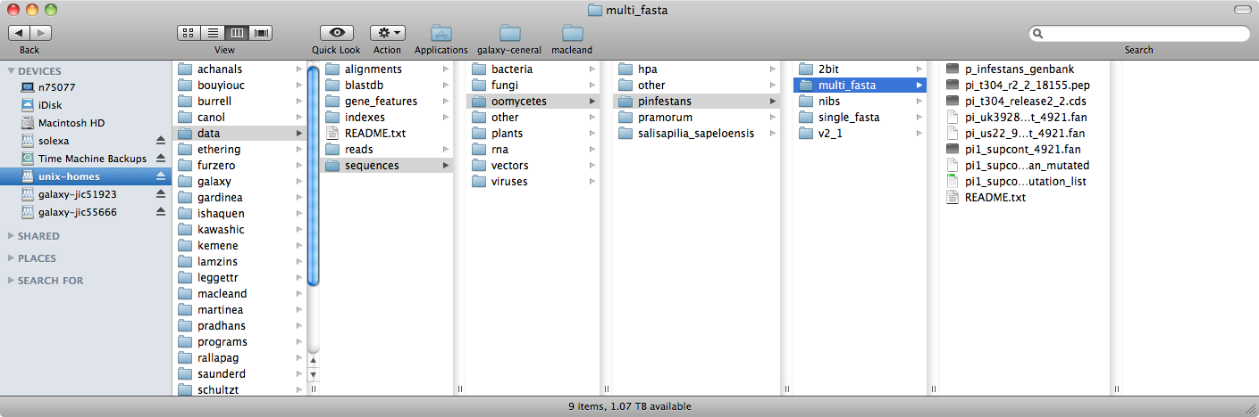
Systems Development
SOP for common tasks – keeping house
Shared Data
Don’t inconvenience
Make access easy
Make messing it up hard
Common data storage – results and raw data
Notes:
A very simple, but effective thing we did was to take hold of everybodies data. Somewhat ruthlessly, in fact. We prevented anyone from using data onto our system until it had been properly registered in a simple in-house data structure. This was just a semantically ordered set of folders that allowed each bit of data to have a natural resting place, and that promoted easy finding. The database was kept ‘clean’ by having a README text file that users described their data in. Anything not in the README and not described properly we threatened to move.
This is simple to set up and simple to manage and easy to manage with a few housekeeping scripts so served us all well.
This is not a clever way to do things – its in no way a real LIMS, but it’s a low first step that gets these data hygiene practices working with the minimum of fuss. It helps you have everything in order by the time you get round to getting your LIMS in order and it can be done on a per lab basis by a single operative.

Slide 26

Galaxy
The missing bioinformatics GUI
Workflows – great for sharing ‘vanilla’ analysis protocols
Customisable – great for running in-house scripts / pipelines
Notes:
Another thing that has been a great help, particularly for researchers with more occasional bioinformatics needs, or a real aversion to the command line is the Galaxy Software. You can think of this as a missing user interface for bioinformatics.
Galaxy allows you to choose tools with the mouse from this list and start chaining the output of one tool into the input of others to make re-runnable pipelines.
Galaxy just wraps existing bioinformatics command line tools. So all the standard software can be incorporated. There’s an app store for Galaxy, so installing tools is very easy.
From our point of view this is great, we can share these out to be modified as necessary and from the biologists point of view it really lowers barriers. The workflows also simplify method publication, the workflow can be published as a supplemental very easily.
We installed this locally and have a custom setup, but there are numerous public servers you can use

Slide 27

ADVERTISEMENT
http://gcc2015.tsl.ac.uk
Notes:
We like galaxy so much, we’ve got really involved. I run the UK Galaxy Community and I’m hosting the Galaxy Community Conference at TSL next year. If you are interested in Galaxy either as a biologist who wants to learn it or an informatician who wants to run it this is the best conference.
Around 250 people attend and the first part is all training, the first days are dedicated to workshops run by the galaxy developers themselves.
So please consider yourselves, formerly invited.

Slide 28
iPython Notebooks
Reproducible and interactive data exploration
Notes:
Another thing that has been incredibly useful, is the adoption of iPython notebooks. These are live coding documents. The thing runs in a web browser and provides a coding environment in which you can write code and develop an analysis in a live notebook. Plain text and output from computations can appear in the same document so the write up gets done along side the analysis. These things are easy to share so your lab mates and colleagues can see exactly what you did, in what order in a way that its hard to see from a jumbled collection of scripts . They provide an excellent way of showing exactly what was done in a particular piece of work.

Slide 29
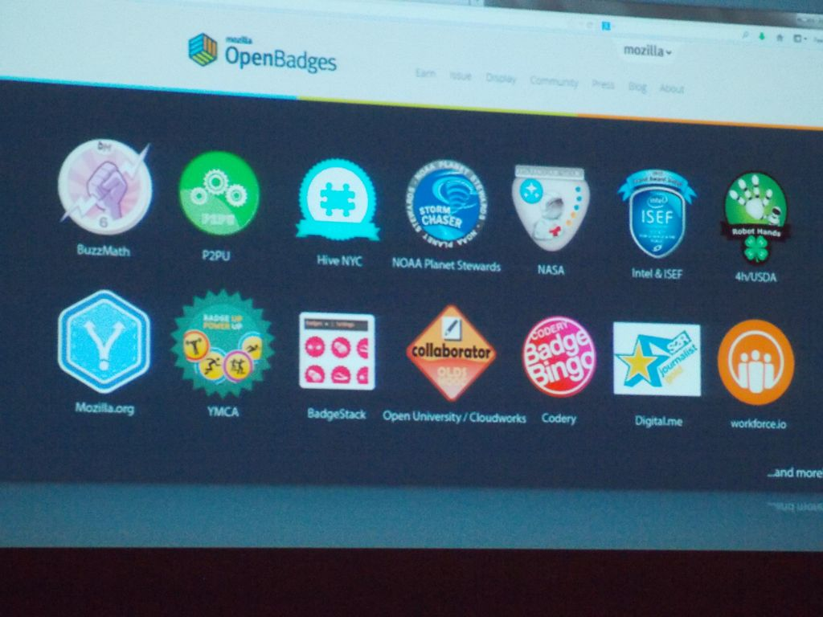
Photo by HASTAC-DML - Creative Commons Attribution-NonCommercial-ShareAlike License http://www.flickr.com/photos/29677268@N06
Created with Haiku Deck
Notes:
When it comes to getting micro-contributions back from individual specialists, then we have a very different problem. First of all, the biggest hurdle is the publish-or-perish imperative through science. As I’ve mentioned, scientists need publications. At the moment, pretty much the only recognised research output is the paper which is why people sit on their results for so long. But open science movements are pressing on and having some effect so there may be opportunities to start valuing much smaller bits of research.
This is key to effective crowdsourcing. People do it because they want to help, they keep doing it if they feel they are getting credit when it is due and we need to start looking at mechanisms to foster this behaviour.
So we’ve been implementing reward badges into our tool stack.

Slide 30


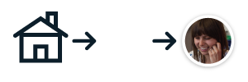

Mozilla OpenBadges
Certification of new skills
http://openbadges.org
earn
issue
display
Notes:
We’ve also moved towards helping the people we train to certify their skills, using the mozilla open badges scheme. We award badges for people completing various parts of our training.
As a person picking up a new skill, you’ll be able to earn these badges for accomplishment.
As an issuer, we will certify the content of the course and the skill you’ve attained so that you can then
display a verified badge in a web portfolio and show off your skills. Basically, it’s a way of verifying that a person has genuinely got a particular level of skill, which can really help sort out those who can do something, from those who claim they can.
For employers at TSL, these badges and the skills they cover provide a skills list by which you can assess the skills of candidates

Slide 31
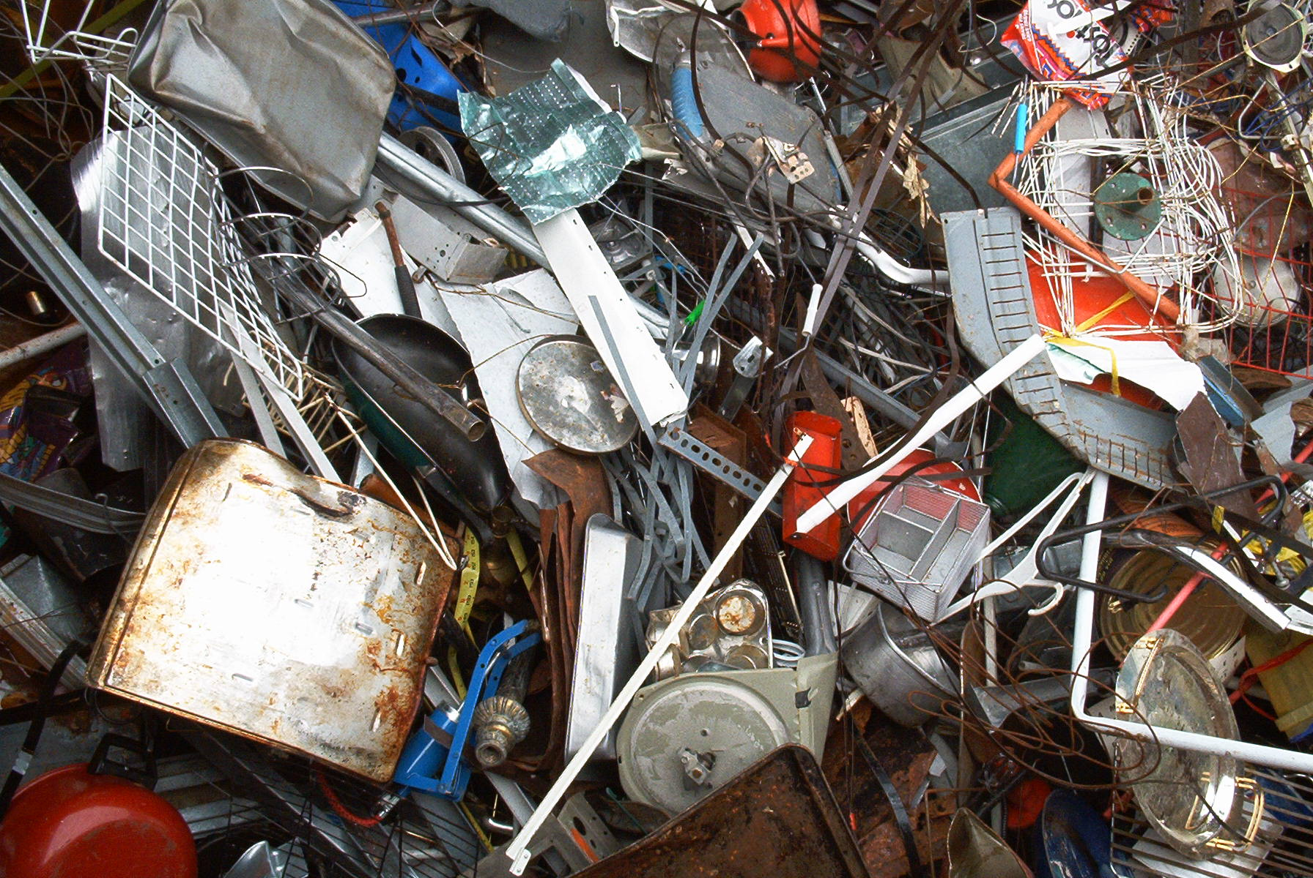

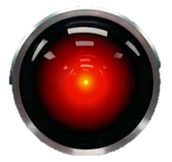
TSL cluster upgrades
move away from ownership of hardware
towards flexible, scalable, cloud-service
60 x 4 – 32Gb RAM cores
8 x 128Gb RAM cores
21 Tb storage
160 x 128Gb RAM cores
32 x 256Gb RAM cores
70 Tb storage
incrementally expandable
Notes:
We ve also seen the upgrade of the cluster hardware
we’ve moved away from owning the actual hardware and being responsible for its upkeep
towards a flexible cloud based model in which we pay for computing power as a service.
This model is more cost effective per unit of computing power and allows for incremental expandability.
Ownership is less important than access and we’ll be the first customers on the service provided by TGAC with our own corner of the resource.

Slide 32
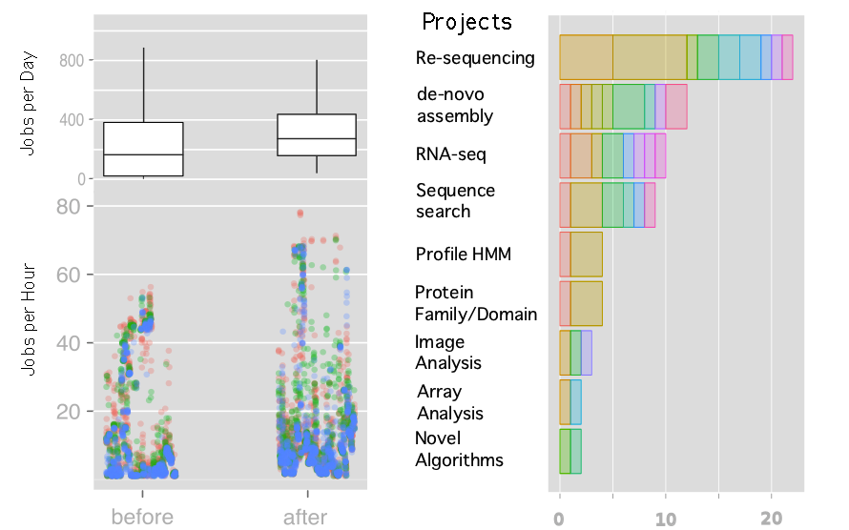
Did it all work?
Cluster Jobs
Projects and Researchers
Notes:
So, to a degree our training plan was a success. I found it really hard to come up with a good metric for deciding whether this really worked. I settled on number of jobs submitted to the cluster in the six months before and after. We did see a significant increase, suggesting we were doing more work! And we did see a proliferation in the number and types of projects that were being carried out. Our conclusion was that we’d had a positive effect on the work of the lab through our training.

Slide 33

UNSER HERR FALSCH
Notes:
And so our approach did work, but it seemed to me it was not working as well as it might. The scientists who were benefitting most seemed to be the ones who might have found their way through bioinformatics anyway. They had a bioinformatic tendency. And most people are not so inclined, most people don’t think the idea of programming or statistics are so very cool, apparently Im in a minority. So I was getting something wrong when it came to understanding what my classes needed and I needed to deal with that.

Slide 34

Lab skills for scientific computing
“We save researchers a day a week for the rest of their careers”
Greg Wilson
Notes:
And it was then that I discovered Software Carpentry. They have the same mission as us, but they go about it in a completely different way than I did instinctively
They teach the boring stuff for science computing that actually works – not the stuff that geeks like me like to enthuse about.
Their tagline is that they Save researchers a day a week for rest of careers
I’d like to tell you a bit about what Software Carpentry have learned about teaching and training and how it helps out with those trying to implement this themselves

Slide 35
A Core Course
Open source lessons in scientific computing
Unix shell
Git / GitHub
Python (or R)
SQL
task automation
tracking and sharing
modularization
structured data
Greg Wilson
Notes:
The hook is that with software carpentry we are teaching the Unix shell, the git / github system for versioning. Python or R and SQL.
The truth is we’re teaching them something more fundamental how to automate repetitive tasks, how to track and share code, how to modularise code. The point is to teach them how to write code that is modular, readable and testable and that those are the same thing. We don’t teach them SQL so they will use databases, but so that they will understand and make better use of structured data and know the difference between structured data and unstructured data .
So it’s a kind of bait and switch, if you tell people you're going to talk about concepts you lose them, but if you tell them you’ll teach a tool they’ve heard of they get more excited and turn up.

Slide 36
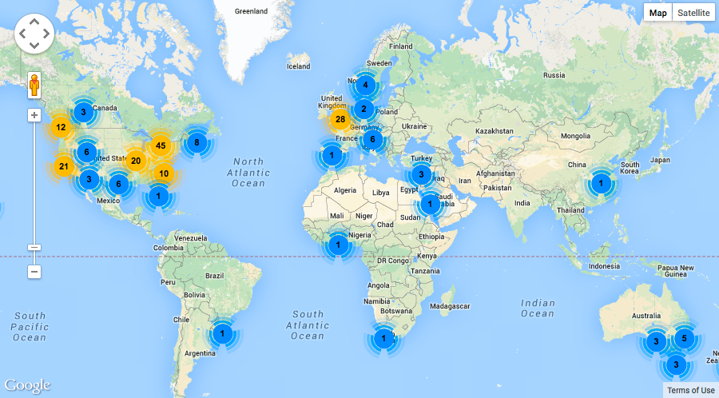
Greg Wilson
Notes:
SWC is becoming a worldwide thing. Since 2012 they’ve run over 200 2-day workshops they have a team of 230 instructors and reached 6800 learners. Most workshops have been in Europe in the US but they’re spreading.

Slide 37
Lessons Learned
Teaching scientists to compute
Lesson 1:
Most scientists think of programming as a tax they have to pay in order to do science.
Greg Wilson
Notes:
The most important thing these guys have realized, is that most biologists aren’t interested in programming, they aren’t any more excited about programming than they are about statistics. Bioinformaticians and programmers are a bit odd in enjoying it, so geeking out when teaching this stuff and teaching programming for its own sake really loses a general audience. The motivation they have is in that they can do new science with what they learn.
This is a very important insight.

Slide 38
Lessons Learned
Teaching scientists to compute
Lesson 2:
The curriculum is full.
f1000research.com/articles/3-62/v1
Greg Wilson
Notes:
People tend to agree that computing should be taught as early as possible, in high school or even earlier. But until you can work out what to leave out. Languages? Gym? Maths? Basically, you have a problem, so its probably going to remain a challenge at Undergrad and graduate level for a very long time, and that’s the reality of the situation.
You can see all this in software carpentry’s paper.

Slide 39
Lessons Learned
Teaching scientists to compute
Lesson 3:
We know a lot about how people learn and how to teach them.
Greg Wilson
Notes:
Humans already know a lot about how people learn and how to teach them.
Most people in science and engineering, tend to dismiss social science research but there is a ton of useful educational stuff that works.

Slide 40

Background reading for trainers
Greg Wilson
Notes:
This is a key text for anyone coming from an academic background wanting to start training groups of their peers. Its from a group of workers at Carnegie Mellon university. It’s a key secondary resource: it can help you with things like “do you want to know whether multimedia resources work better than printed ones” Turns out “it depends” this book makes good summaries and leads you back to the primary research on the topic.
If you are teaching this is a really good resource for anyone who wants evidence backed educational decisions.

Slide 41
What affects learning?
Effect on teaching/learning speed of classes
http://tinyurl.com/hattie-effect-sizes
Shifting schools: - 0.34
Web-based learning: 0.09
Teacher subject matter knowledge: 0.12
Class size: 0.21
Motivation: 0.48
Concept mapping: 0.52
Peer tutoring: 0.55
Formative evaluation for teachers: 0.70
Absence of disruptive students: 0.86
Greg Wilson
Notes:
Here’s a particular highlight,
John Hattie in New Zealand has been doing metastudies of tens of thousands of educational studies over several decades and he looks at effect sizes. Basically a percentage of a standard deviation. And one standard deviation is roughly equivalent to a year grade in North American high schools. Very roughly.
So shifting schools costs about 1/3 of a class year. Web based learning – not worth having. Those of you who have kids in schools that are rushing to buy iPads etc, tell them to stop.
Teacher subject knowledge isn’t so important at school level. Its better to be good at teaching.
Class size in itslef isn’t a much of a problem. Reducing it gets you about a fifth of a year. More important actually is the absence of disruptive students. That includes over eager students who want to get there questions answered.
More surprisingly important is things like concept mapping, peer tutoring and formative evaluation of teachers. All of which we now absolutely know makes a difference in learning and can put into our training practice. If we want to be effective trainers, we need to really overhaul the lecture/workshop and those dreadful feedback forms we hand out at the end.

Slide 42
Lesson 4:
Most people would rather fail than change.
Greg Wilson
Notes:
Most people would rather ignore what we know than change their working practice or business plan.
Climate change, anyone?
We know all this stuff but its tricky to change institutionally.
We have lots of empirical evidence but we don’t include it often enough. So it can be very hard to make change happen…

Slide 43
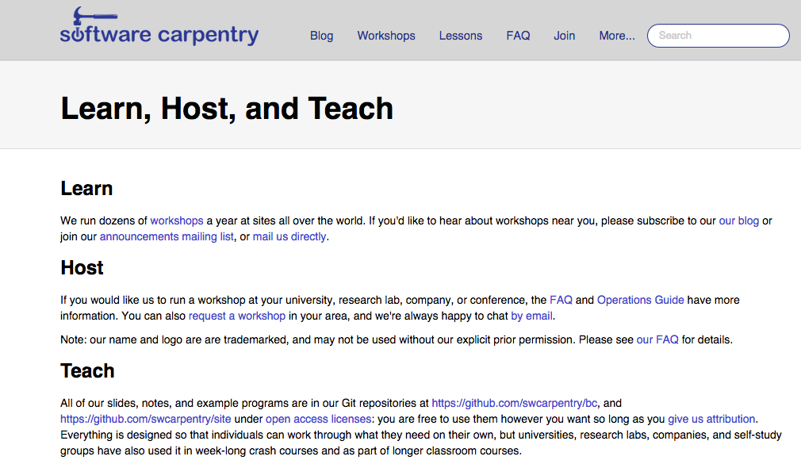
Free and Open Source Learning
http://software-carpentry.org/pages/training.html#teach
Notes:
Software Carpentry really build on these lessons in their workshops and materials. They provide a great deal more interaction and more materials with many useful and motivating examples and ways for the tutor to receive feedback during the lessons and after.
The lessons are live-work, so no lectures up front and very little tedious theory. And work is pair based, so everyone gets a feel for how much everyone else is finding it hard and you can break down the fear of the subject that way
This results in what feels like a very much more successful training exercise.
The best thing about software carpentry is that they are a not for profit organization, you can use and contribute to their materials and lessons. Its Open Source education. They’ll even train you to do training in their way.
You can see lots more on this and get the materials at Software Carpentry’s own site.
So this has become the new basis for our training, we have become qualified Software carpentry instuctors and we do think that it is working and I’d like to show you some of the fringe benefits me and my team and my department have discovered by implementing a supportive training scheme.

Slide 44
A problem
We need to measure stuff to show that all this is working.
We need answers for funders.
Greg Wilson
Notes:
A problem they still have, and we still have is that we don’t know how to quantify whether its working or not.
But we don’t know how to measure productivity of a programmer, or the productivity of a scientist, so you can’t get the answer to this sum ..
We can do surveys and interviews, but the problem is with this sort of training it changes completely what you are doing, so there is no before and after, there is no simple metric oyu can use to measure the effect.
But we do think that it is working and I’d like to show you some of the fringe benefits me and my team and my department have discovered by implementing a supportive training scheme.

Slide 45
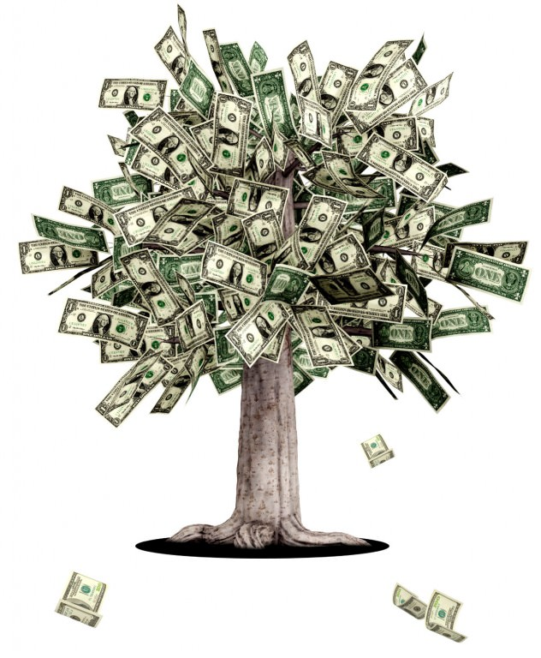
How do you start a genomics project quickly or without a great big grant?
Notes:
So by being so closely involved in the work through training and direct involvement, we’ve been able to spot many avenues for tools that bridge the gaps in our research. We’ve produced a number of open source pieces of software that have assisted our genomics research and had wide impact.
And the first big question we’re looking at in our group – How do you kick off a new project without front loaded funding – How do you get the genomics resource for a brand new pathogen no-one has any knowledge about?

Slide 46






Notes:
One way is to take a cue from the open source software world and ideas from open access databases.
This is a world where every piece of information remains available to anyone at any time, and the people contributing or using feel an intrinsic value in contributing to the over-all goals of the project.
And this isn’t a model we really have in science - normally we have to wait for funding of relatively isolated groups on specific projects and then,
because we are relying on high profile publications to get further funding we sit on results which makes the cycle worse.
and release data only when we’ve finished our own analyses and are ready to publish.
We can kickstart knowledge by making whatever data we can generate and can find instantly available, even before it is analysed, and let whoever can help, do what they can
The practical upshot of this is valuable data gets to many more people who can deal with it much more quickly and more is learned quickly.
We got a great chance to apply this sharing principle for emergent pathogens a couple of years ago

Slide 47
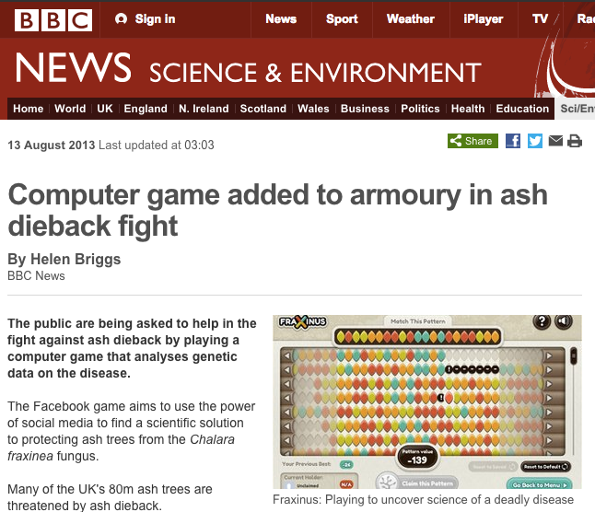
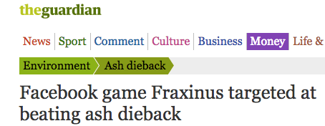
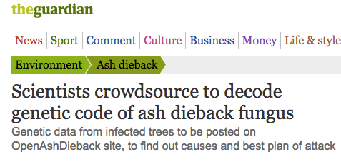
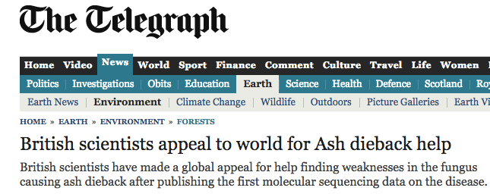

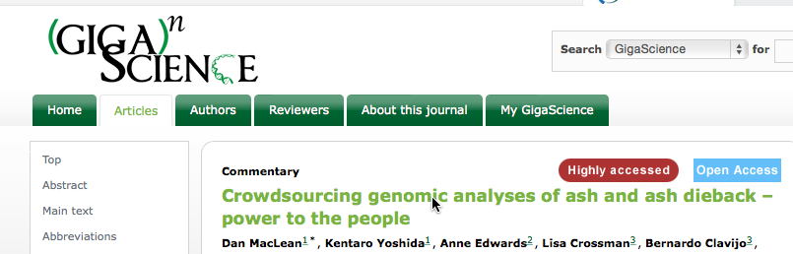
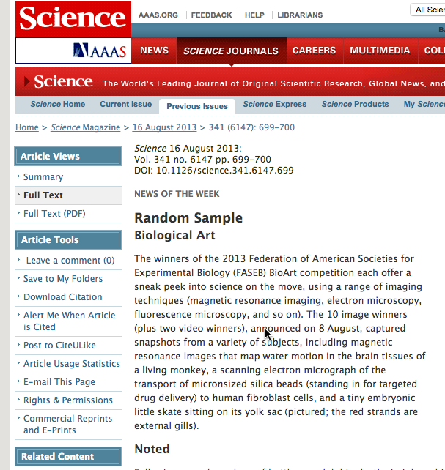
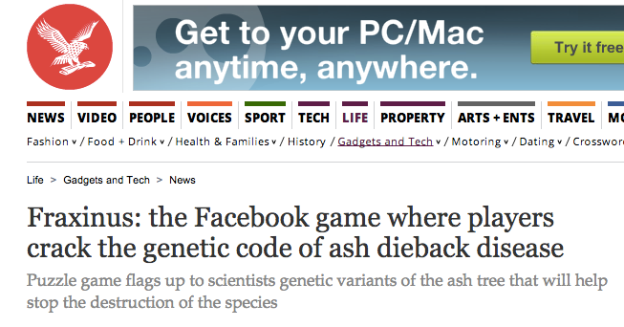
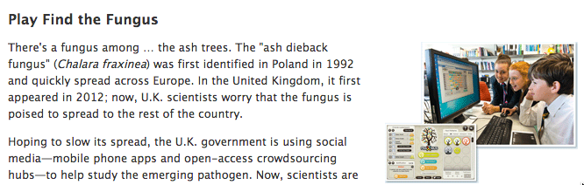
Global Impact Genomics
Notes:
We’ve had some serious impact with our ash dieback crowdsourcing project. This has been featured on the national and international news media, being featured on TV and radio across the UK and in the US. And I’d like to show you how that was a bioinformatics driven project that synthesised well with the wider biological programmes at TSL.

Slide 48
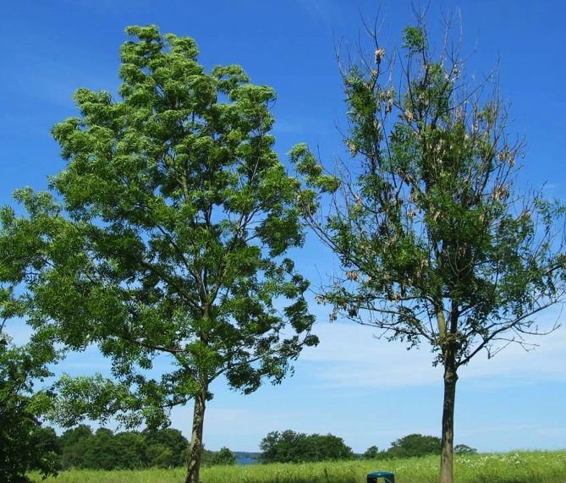
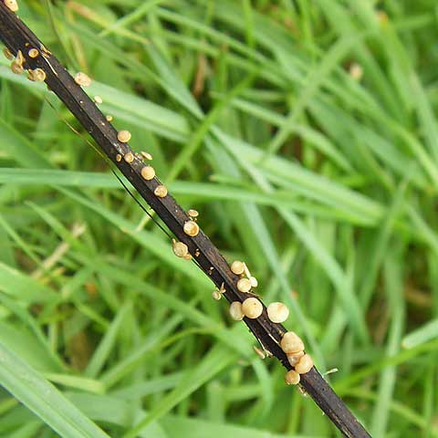
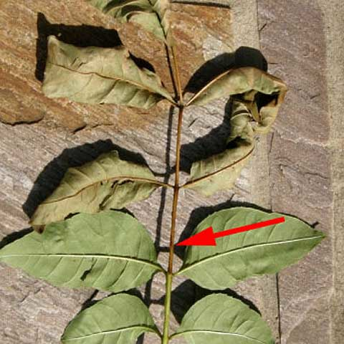
Esche (Fraxinus excelsior)
Notes:
Ash, or Fraxinus excelsior, is an important tree and has been so throughout history.
Ecologically Ash is vital, it’s a fast growing tree that crops up quickly in gaps in woodland and can support a massive range of biodiversity.
Ash lives to about 200 years old although when tended by coppicing practices it can live to be about 1000 years old. There are ash woods in norfolk dating back to the time of the vikings
This is what ash dieback looks like
Two roadside trees, The left tree is still looking unaffected this year whereas the right tree is now severely affected and producing many epicormic shoots, and the disease is even starting to affect the growth and the size of it’s crown.
Ash dieback is clearly noticeable as lesions and cankers on stems and branches, these are visible throughout year.
Throughout summer you can also see leaves with brown leaf stalks.
The causal pathogen makes fruiting bodies on fallen leaf stalks in spring.

Slide 49
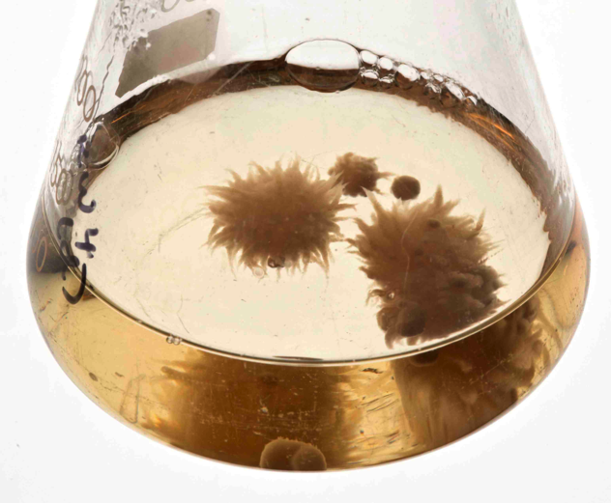
Hymenoscyphus fraxineus
Notes:
The disease is caused by filamentous fungus (teleomorph) Hymenoscyphus fraxineus
Its also called Chalara fraxinea, this is the name of the anamorph stage, lots of people call it chalara
The picutres are taken C. fraxinea growing in liquid media.
And when this was reported in the wild in the UK, it caught everyone a bit by surprise as it seemed to spread across the country really quickly and there was something of a national outcry that something must be done

Slide 50
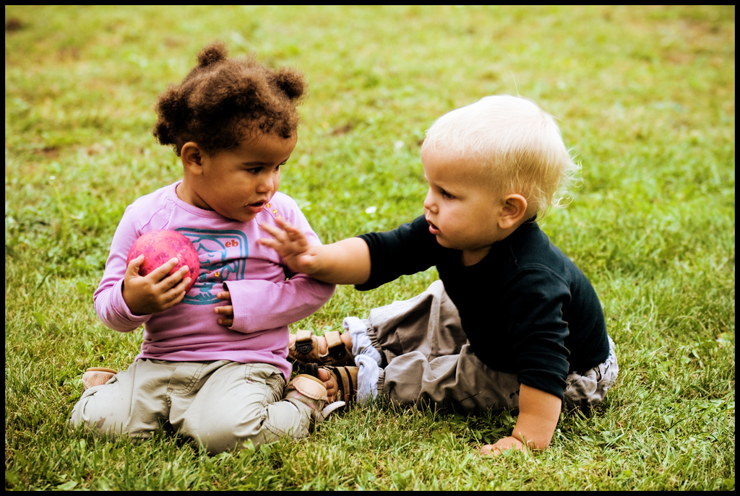
Science is too slow in emergencies
Structure of science inhibits sharing
Duo Penotti by Sabine75 on flickr, licensed under CC-BY 2.0
Notes:
Scientists have always been really bad at responding to a quick change in situations.
the usual business model we have as scientist is inhibitory to a joined up, fast response.
Normally we have to wait for funding of relatively isolated groups on specific projects and then,
because we are relying on high profile publications to get further funding we sit on results
and release data only when we’ve finished our own analyses and are ready to publish.
In situations where speed and collaboration is important this model provides too little, too late.

Slide 51
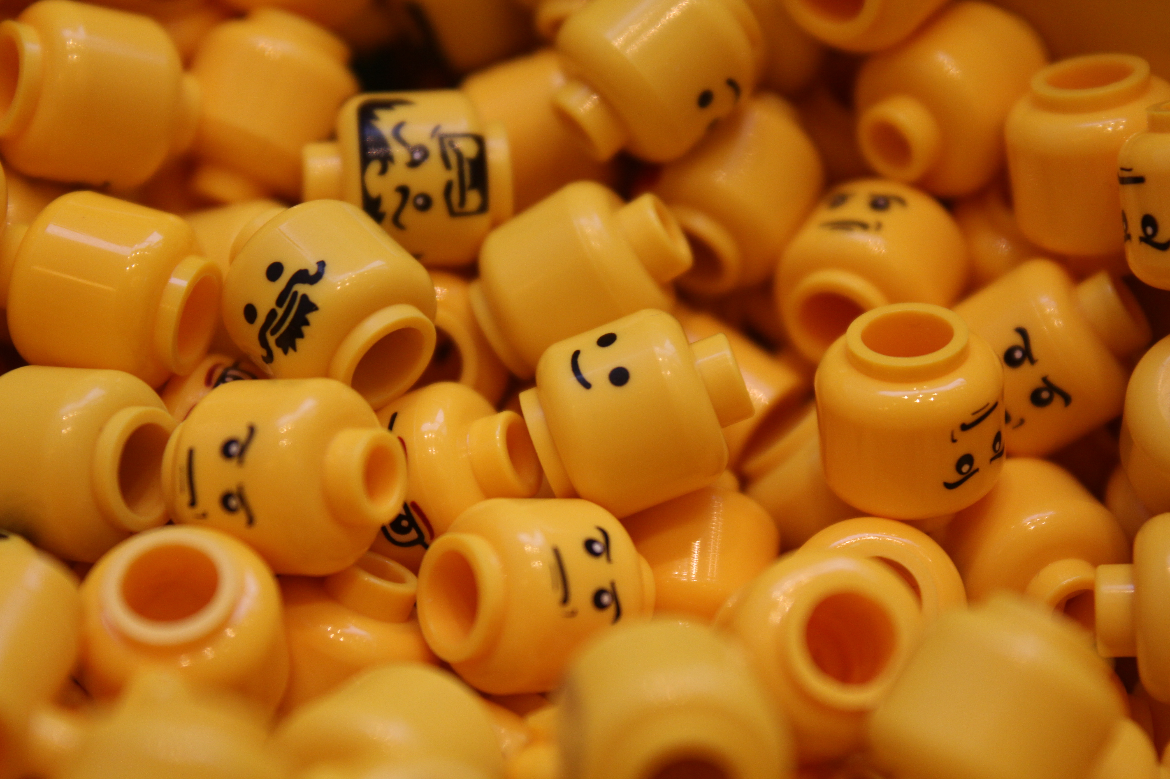
WE NEED NEW MODELS
“two heads are better than one”
Lego faces by Sunny Ripert on flickr, licensed under CC-BY-SA 2.0
Notes:
So we need new models.
And we work with the principal that two is better than one so to try and maximise the speed at which we can respond and to make the most of people and data power, with ash dieback we’ve applied a crowd-sourcing approach.
Crowdsourcing in our project is defined as the process whereby we make whatever data we can generate and can find instantly available, even before it is analysed, and let whoever can help, do what they can. Our initial crowd is scientists,
The practical upshot of this means valuable data gets to many more people who can deal with it much more quickly and more is learned quickly.

Slide 52
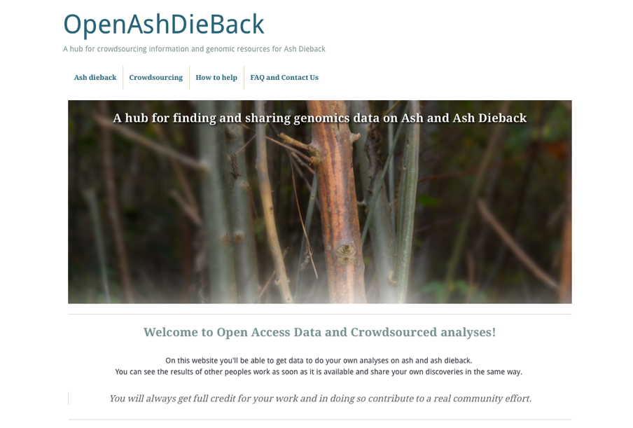
http://oadb.tsl.ac.uk
Notes:
So to embody this and fight back against Ash-dieback, a group of us have come together to bring Open Access data principles to try and fast-forward collaboration on genomics of ash and ash dieback.
We’ve put up a hub website to facilitate this, called OpenAshDieBack. Which is at this URL. This website contains links to our data repo and blog posts describing the analyses and data that people have contributed

Slide 53
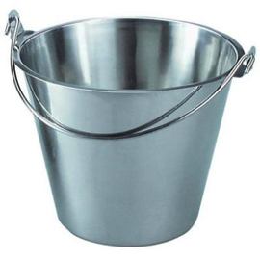


ATTRIBUTION OF CONTRIBUTION
Git and GitHub as a versioned database
push
back
pull
data
make change
Notes:
The data and results themselves are actually hosted externally on the public website, github.
If you’re not familiar with github, it’s a peculiar sort of social networking site
Github is a programmers social coding website. Github is really great at tracking changes to files and keeping records of who made these changes.
The work cycle is really straightforward: you start the day by pulling the latest version of the data from github,
you make the changes/additions/new data that you think are appropriate and push it back.
Github sits in the middle keeping track of what changes were made and who made them.
That’s the key reason for using github, because its critical that we make proper attribution of contribution.
If we’re going to get people to give their time and effort for free, we really need to make sure that we’re giving credit for it.

Slide 54
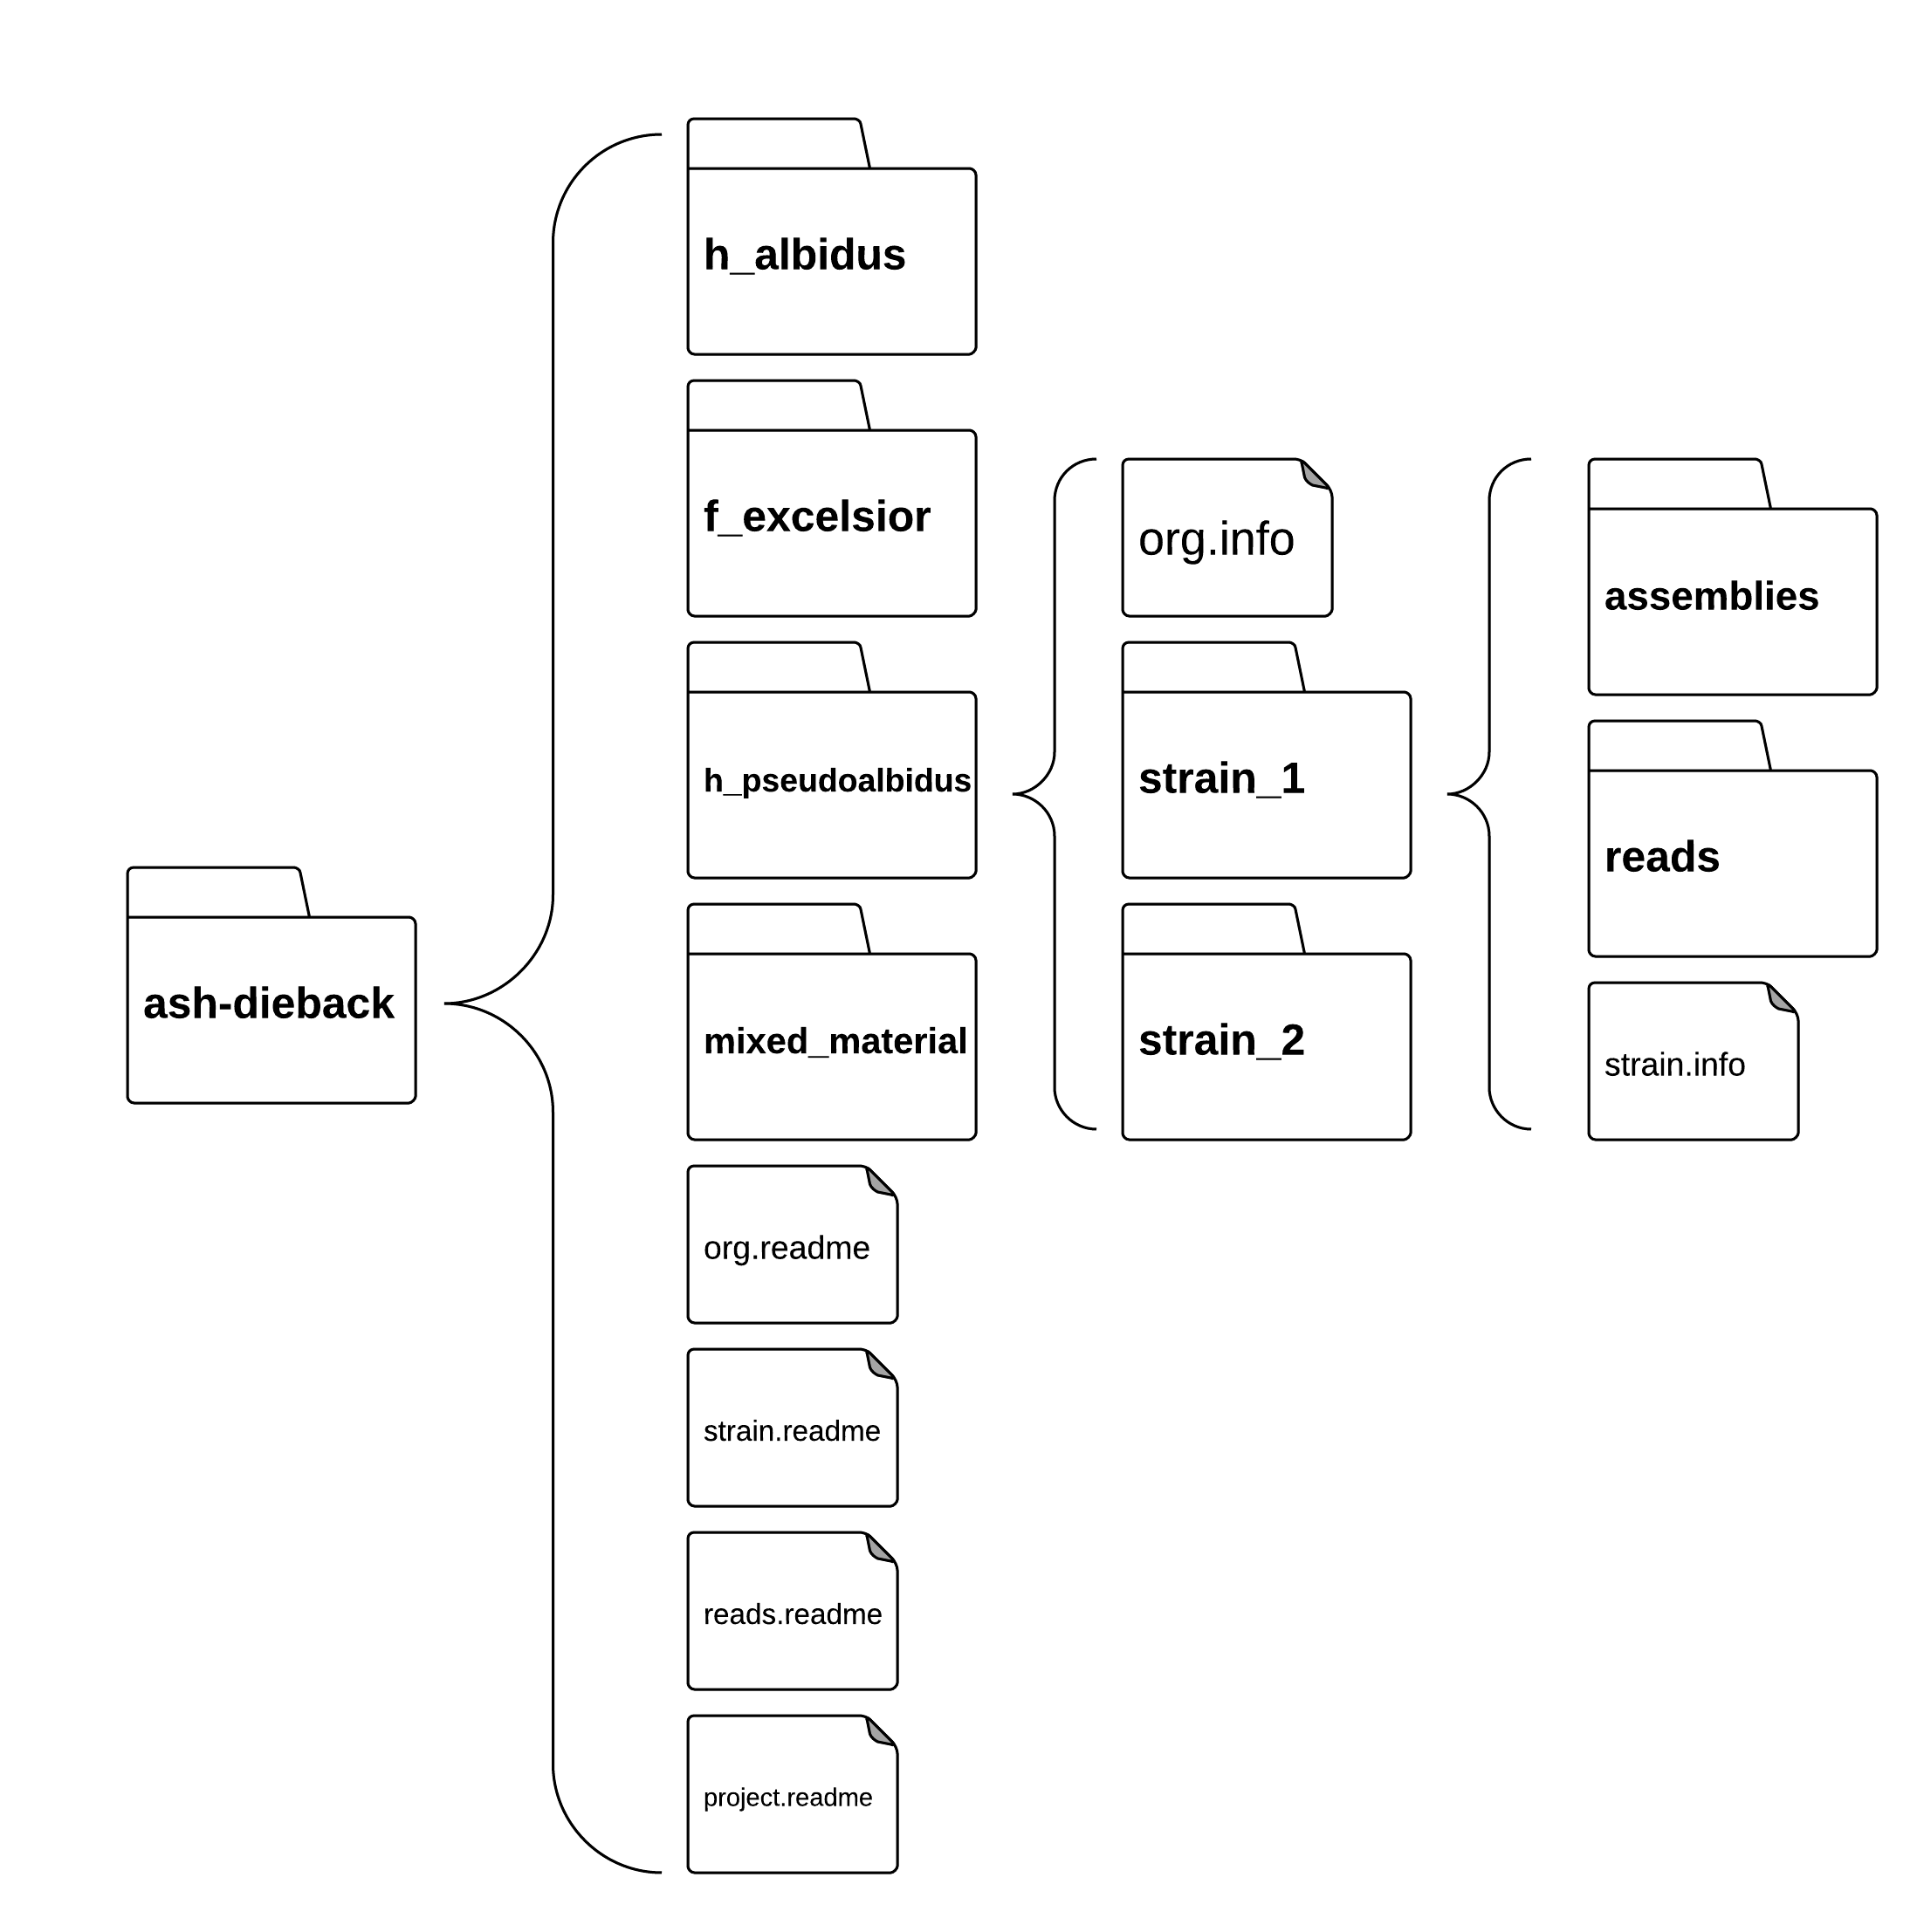
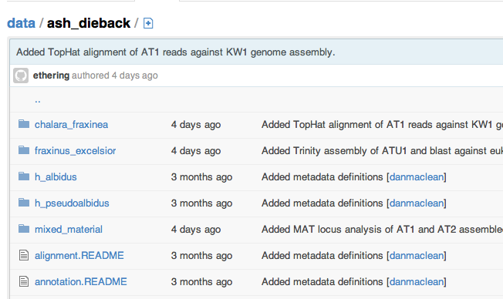
A simple ‘folder’ database
Structure of science inhibits sharing
https://github.com/ash-dieback-crowdsource/data
Notes:
This is the repo itself,
Basically just as directory structure – semantically organized so each dataset and its meta data has a fairly natural place to go.
To find anything its possible to just click through the higher level categories, like species down through strain to the different datasets.
At each level we have these metadata files that explain what is in the folder and how it was generated. It’s a functional, basic just enough sort of database that is good enough to get us going. We don’t ever intend that this is a replacement for databases of record like SRA, we fully expect that all the data in here that can be pushed to the major DB’s will be.

Slide 55
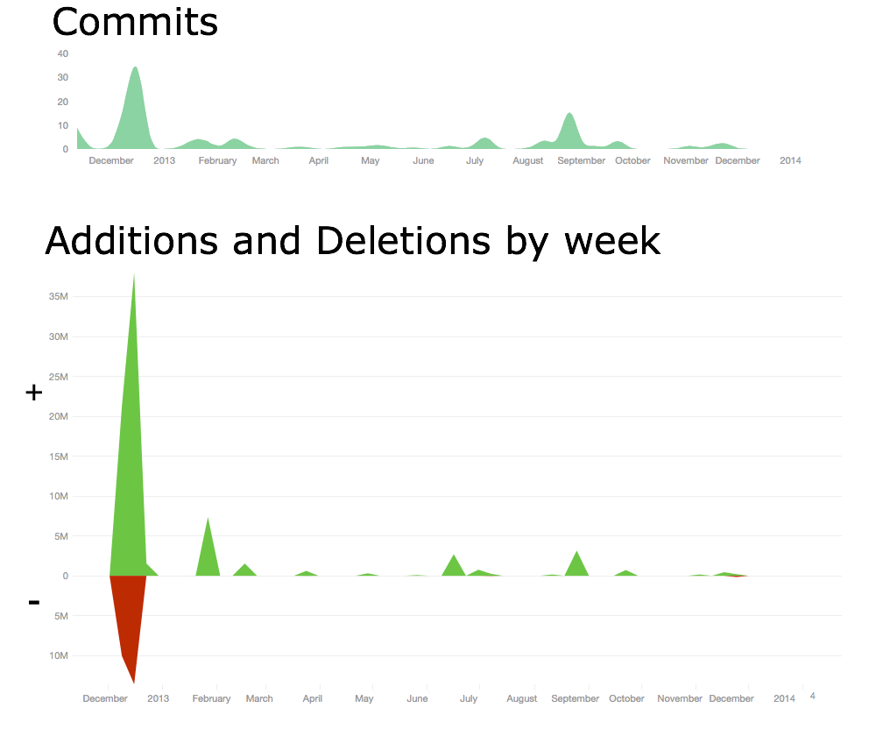
A THRIVING COMMUNITY
Crowdsourcing stimulates involvement
http://dx.doi.org/10.6084/m9.figshare.1005000
Notes:
We had a great start and its continued to draw interest. We stimulated a lot of involvement.
This top figure shows the commits, that is uploads, to the database over the first year. We got over 170 different contributions in this period, from at least 43 members. That’s a good size community from nothing.
The amount of analyses is great too, its quite hard to quantify analysis per se, but a rough guess is the number of lines of stuff added to the database. This peak of additions represents over 35 million new lines added. That figure doesn’t include raw data, raw reads and such, just the derived analysis output.
As you can see we’ve had multiple periods of large contributions over the year which has resulted in 37 separate blog posts about analyses from
So we managed to generate a really significant community in a very short time.

Slide 56

CROWDSOURCING GETS RESULTS
A repeat-rich genome
Bernardo Clavijo,
Manuel Corpas,
Matt Clark,
David Swarbreck
- TGAC
http://dx.doi.org/10.6084/m9.figshare.791640
Notes:
The analyses are going well,
We’ve been able to push quite far through crowdsourcing analyses and are starting to build up quite a good story about our pathogen.
TGAC in Norwich provided us with DNA sequence and a first draft assembly, which is what we see here. Contigs are arranged around the outside of the circle with gene densities in blue.
The green inner track is repeat sequences and the two pink tracks are back aligned read coverage and sequence GC content.
We’ve seen from this assembly that the structure of the genome is very interesting, we get these regions where GC content plummets and coverage and repeat sequence shoots up suggesting that the genome is a non typical reduced pathogen genome in which there are many AT-rich, repeat dense islands scattered throughout.

Slide 57

Identifying effector candidates
Diane Saunders
- JIC
http://dx.doi.org/10.6084/m9.figshare.1005005
Notes:
We also examined predicted proteome of H.pseudoalbidus KW1 for potential secreted proteins
We then clustered all proteins based on sequence similarity using OrthoMCL to create these tribes, the groups you see in the diagram, we annotated the protein tribes for known effector features
WE see a few common groups like those expressed during infection, those with common effector motifs, etc. And with this we identified a repertoire of effector candidates.

Slide 58

METAGENOMICS
Christine Sambles
David Studholme
- U of Exeter
http://dx.doi.org/10.6084/m9.figshare.807684
Notes:
We’ve also received metagenomic analysis of the mixed material samples on OADB. These showed us the range of organisms potentially co-habiting with the fungus, in particular we noticed Togninia
Species which has been observed in dead vascular tissue of declining ash tree branches in the US.

Slide 59

NOT A ROTTER
H.pseudoalbidus doesn’t have the genes for wood digestion
http://dx.doi.org/10.6084/m9.figshare.791635
Notes:
As it’s a tree pathogen we also inspected the genome for genes that are typically involved in lignin and cellulose degradation, the major components in wood.
The genome was compared with those from a load of basidiomycete wood rotters, and counts of typical degradation genes made, H.pseu pops up down at this end, with virtually none of the sorts of genes that are typically used in digesting wood, indicating that it gets into the tree without directly attacking the wood.

Slide 60

TOXINS ENCODED
Nep1-like protein in the genome
Suomeng Dong
H.pseudoalbidus hypothetical NLP
NLPpya 3GNU
http://dx.doi.org/10.6084/m9.figshare.1005010
Notes:
Suomeng collated seven fungal and oomycete Nep1-like protein (NLP) sequences from public databases and used these in a tblastn against the h.pseu transcript assemblies. He identified a transcript with high similarity to NLPs,
The protein sequence was then used for protein structure modelling, with the published NLPpya 3GNU as a template. This analysis shows that the predicted protein we identified carries all the key residues for NLP cytolytic function, these red ones here.

Slide 61

Photo by mars_discovery_district - Creative Commons Attribution-NonCommercial-ShareAlike License http://www.flickr.com/photos/17016583@N00
Created with Haiku Deck
Notes:
We realised that to really add value to our data then the important thing is to bring in as many biologists and not just genomicists, to get involved and liberate the genomics data and expertise to them and get the insights back from them.

Slide 62


CROWDSOURCING GENOME BROWSER
Reading by JanH on flickr, licensed under CC-BY-NC-SA 2.0
Discussion by Bestorg on flickr, licensed under CC-BY-NC 2.0
Notes:
And we’re trying this through new tools and interfaces.
We’ve put together something we’re calling a crowdsourcing genome-browser. Im sure that you’re familiar with the idea of a genome browser.
Our crowdsourcing browser relates to that in the same way that this guy reading his book relates to these people having a discussion. Our new crowdsourcing browser allows us to take in things like annotations, and experimental information straight into the repository while providing functionality like BLAST. The info is recorded piecemeal and reflected back to the other users of the tool directly.

Slide 63


gee-fu – crowdsourcing genome browser
Notes:
We call our tool Gee Fu and this is the Software stack. Its based on common open source tools, the inimitable WebApollo being the major genome browser style component, GOLLUM is a git based wiki engine, every object, not just features can be annotated through this wiki, and we also used sequence-server, a ruby gem that implements a BLAST server for sequence based searches. All these are tied together through Gee fu, which is a piece of middleware that acts as an integration layer between other tools
it acts as the dispatch engine for data to the GMOD project web-Apollo genome annotation browser, as a feature linking engine for the wiki and as the sequence store for a BLAST server.
It coordinates automatic exchange and concurrency of data between the apps and the github repo, making sure that contributions from these other tools are tracked into the github repo
It provides a restful interface to the repo data and still acts as a feature and meta data editor in its own right.

Slide 64
gee fu – in browser annotation
Notes:
Its major function is annotation, the tool provides ways of directly editing and annotating gene models as you browse, and propogates all the edits directly to the data base so all other users can see immediately

Slide 65
gee fu – in browser analysis
Notes:
It also allows sequence searches of the provided data too, and fully cross links this back to the annotations and reports Kind of like a “build your own NCBI”, but restricted to a new and growing set of information for ash dieback

Slide 66

Notes:
We also added features to manage badge awarding as contributors used Gee Fu.

Slide 67




Fully ReSTful
Name | Language | Libraries
GeeFu Core | Ruby | Rails, Bio-SVGenes, Gollum
WebApollo | Java, Javascript | JSOM, Stax
Merit | Scala | Play! Framework 2
Credit | Go | MGO, Martini
Notes:
The whole stack is built on a number of technoloiges and encompasses a wide variety of languages but each has a fully restful API, so intercommunication is very easy. And each component can be built into other projects as needed.

Slide 68


Merit: A web app for managing and issuing open badges
MERIT
https://github.com/wookoouk/merit
Notes:
Merit, the web app for managing and issuing badges is very easy to install and use, it has a simple form based interface for creating a new badge, you just need the PNG file with the badge design and URL with the assertion and you are good to go/

Slide 69


Scoreboard: A WebApollo plug-in for specifying and keeping track of activity
SCOREBOARD
https://github.com/wookoouk/Scoreboard
Notes:
Scoreboard, is a Javascript WebApollo plug in that sits and listens to a users activity and maintains a database of activity that relates to a badge.
Within scoreboard, the badge issuer can specify the rules by which a badge should be issued and once one of those thresholds is passed it messages Merit which will issue the badge. So you might have a badge for changing 5 exons or adding a protein, all the steps along that path are kept record of and badges issued as soon as they are earned.

Slide 70


Feature Editor
You have earned the ‘Feature Editor’ badge, Click here to collect it
Notes:
We also added features to manage badge awarding automatically as contributors used Gee Fu. We hoped that this would incentivize younger scientists.
The user is kept informed of progress by little pop ups as they work, click throughs allow the badge to be collected

Slide 71

And many more … http://tsltraining.tsl.ac.uk/?page_id=311
Notes:
We provide a number of badges, contribution gets you this open scientist badge, then editing features gets you the feature editor badge at different levels (basically if you do just a couple you get a badge, and a new one when you do the same thing many more times). Submitting large scale experiments like RNA-seq data can also get you a badge.
And its here that we have come full circle, really. We started off seeking to train biologists to do bioinformatics to maximise our science. This gave us time and opportunity and insight us to create new science and inspired us to bring in even more utility to train biologists!

Slide 72

Humans love games
Notes:
We also looked at crowd sourcing members of the public.
A high profile pathogen like ash dieback, particularly in the UK where there is a deep social and cultural connection to the countryside and particularly the woodland suggests that there would be a great deal of public interest in what we’re doing to sort out this problem.
Scientists are terribly outweighed in numbers by non-scientists, people with interest in these issues, who are motivated to use their spare (and not just professional or work time) to try and make a difference in the world.
So we’ve started crowd-sourcing through citizen science projects.
And we took the opportunity to use people power to do analysis of genetic variants that would show up in our sequence data
In many of the variants we want to examine, the computer programs make errors that a human being would not.
High throughput algorithms are error prone in some key parts of assemblies and genomes, like INDELs, or at assembly ends or repeat rich regions.
Scientists correct the alignments that underly SNP calls by eye all the time: So we built a game to allow Non scientists to do this for us and put the SNPs the computer is likely to have got wrong into it.

Slide 73



Notes:
So the game we produced is called Fraxinus, it’s a FLASH only facebook game designed by myself and the BAFTA nominated game company Team Cooper in Sheffield
This is the main game screen of Fraxinus,
Along the top we have Target Pattern, from one of our references. Targets are pre-selected to be the sites the algorithms make a mess in.
The rest of the coloured rows are reads from DNA sequencing experiments.
The player can Shift, insert and delete nucleotides to make best alignment
Score for matches, score deducted for mismatches and creating and extending gaps.
Once player has maximum score they think they can get, they can claim the pattern for themselves and get points for that

Slide 74

Notes:
Extra Value comes from being able to play against your facebook friends. The game allows you to compete directly over patterns. The box on the right contains the patterns you’ve won, but by hitting the steal patterns button you have the opportunity to take a pattern from a friend.
All you have to do is score one point more.
This is valuable to us, because then the patterns get analysed more deeply since many sets of eyes and brains look at each.
The game incentivises this behaviour by awarding more points for stealing than taking a fresh pattern. Thus the winning strategy requires the player to replicate an analysis.
The game takes the colour information from the alignment and returns a SAM format file to a MySQL database on our server along with the players FaceBook name.
We can take this data and put it straight into analysis pipelines.
So playing the game is doing real science. The results the players give us go straight back into our public databases to be used in further analyses.

Slide 75
~35 % of puzzles arranged differently to machine
Puzzles different to computer
6000
4000
2000
0 %
50 %
100 %
Notes:
So has our community really contributed anything useful? The game was designed to improve variant calls.
Well, we’ve analysed the results from our first data set, which contained 10000 puzzles representing just over a thousand variants. We had to split a lot of the variant sites up into separate puzzles because of the large amount of screen space that the reads take up, we could only afford to have about 20 reads on screen and still keep the player sane, so we divided the puzzles up into subsets and there were 10,000 of those.
This graph shows that in about 6500 of those the player aligned no different to the machine, they couldn’t do anything differently. But in almost all the remaining 35 % then the player aligned every read differently and therefore added value.
And each dataset got looked at many times. Our ten thousand patterns received over 154,000 solutions, so we got more than 15 plays of each data set, which is a really good replication rate, even for a statistician.

Slide 76

How do you identify causative mutations without a reference genome?
Notes:
So the next question we focus on, is how do we find the variation that causes useful or interesting traits in a new species. Of course modern genomics approaches have lots of ways of doing this, but they have an absolute dependency on a reference sequence. Building one of those is expensive and time consuming. So we have been developing methods for finding important variation directly from sequence data.

Slide 77
SNPs are “bubbles” in an assembly
CGA
T
GAT
ATT
TTC
TCT
CTA
TAA
AAG
AGT
2
2
T
2
C
1
T
1
A
1
A
2
G
2
T
2
G
A
TTG
T
TGT
A
GTA
1
1
1
CGATTCTAAGT
CGATTGTAAGT
Notes:
You don’t need a reference to find the SNPs. SNPs represent as bubbles in the internal data structures of the genome assembly software,
Assembly software breaks the reads down into overlapping kmers, and by following paths of overlap reconstitutes longer fragments from many reads.
But SNPs cause splits in the assembly path. We can use these bubbles. And by adding an id like colour to the reads then we can mix samples and determine whether a SNP is unique or shared between samples .

Slide 78
Which are the real SNPs?
Method for deciding which bubbles are real SNPs
Six bubble/kmer attributes
Richard Leggett et al PLoS ONE 8(3): e60058. doi:10.1371/journal.pone.0060058
Notes:
We have a couple of programs for finding SNPs. One of these, Bubbleparse is great at classifying and identifying trait linked SNPs, it returns long and accurate lists of SNPs grouped by allele frequencies etc. This graph shows its accuracy around 90% over 100 000 identified SNPs in a proof of principle sample from Arabidopsis.

Slide 79


Linked SNPs in wild potato resistant to Phytophthora infestans
Bubbleparse finds trait-linked SNPs
F1 Manually scored for resistance
Sequenced normalised bulk cDNA of 30 R and 30 S
SNPs linked to resistance expected to be 50/50 Het
Solanum berthaultii (R) x Solanum stenotomum (S)
Walter Verweij
Jonathan Jones
Het Linked SNP | Het Unlinked SNP | Total
14/15 | 8/10 | 22/25
Richard Leggett et al PLoS ONE 8(3): e60058. doi:10.1371/journal.pone.0060058
Notes:
And we’ve successfully applied the system to find thousands of candidate SNPs that may be linked to resistance to late blight resistance in unsequenced wild potato species.
Here we crossed resistant and susceptible potato and sequenced bulks of the offspring – expecting SNPs with allele frequency of 50% - then identified these with Bubbleparse, generating thousands of candidate SNPs in small contigs that could be used in BLAST or other functional searches to find potential variants in Rgenes or other important sequences.

Slide 80




Untangling bubbles with 2k+2
Younsi and MacLean Bioinformatics doi: 10.1093/bioinformatics/btu706
Notes:
In the midst of this we found that the bubbleparse system didn’t find SNPs in regions where the assembly got complicated, like in repeats. The knot on the left is a typical structure in the internal representation of genome assemblies and Bubbleparse just got lost here. The ideal result would be to break those knots into their component parts. So we implemented a system, called 2k+2 that separates these out by carefully walking and enumerating particularly sized and characterised graph structures..

Slide 81


2k+2 sensitive complex bubble detection
TSU1 vs Col0, reads from Schneeberger et al 2011 (1001 genomes)
Blue = 1001 Genomes
Red = 2k+2
Younsi and MacLean Bioinformatics doi: 10.1093/bioinformatics/btu706
Notes:
We ran this algorithm on a range of Arabidopsis ecotypes and looked at the complex regions, those parts of the graph with many branching nodes in. 2k+2 found many SNPs in this regions that were also highly accurate SNPs (mean of 85%) across the whole genome.
Together these programs provide a powerful platform to find SNPs in situations where you lack a reference genome.

Slide 82

Profiled SNP frequency peaks around mutation after crosses
Notes:
Another approach we’ve been taking is to identify the actual causative mutation directly from the sequence or assembly. And to do this we take advantage of the fact that in forward genetic screens, when a mutagenesis is carried out and crosses are done later, we see that the SNP frequency around the mutation we are selecting for fades out as we get further across the chromosome. We can use this pattern to our advantage

Slide 83

GATROC - optimising contig order
Unordered contigs
Ordered contigs
Pilar Corredor-Moreno and Ed Chalstrey
Notes:
When we have a draft assembly of contigs or just reads, then the random order means that the distribution is smoothed out. We can put the peak back by reordering the contigs properly and we’ve been doing this with genetic algorithms that explore permutations and select the most appropriate. This picture shows a version looking for the optimum blue line and improving the permutations at each iteration.
Together the SNP finding and causative mutation finding software are a great package for working with important and possibly disease resistance causing variation in species without taking a traditional genomics path.

Slide 84





HIGHLY USED SOFTWARE
over 35,000 downloads
Notes:
AS bioinformaticians we like to think we’re craftsmen as well,. Its important to us to make high-quality open-source software, we regularly package our internal tools for the bioinformatics user and these have had a significant reception, receiving over 35000 downloads in total to date.

Slide 85



Sweetening bioinformatics
Etherington, Monaghan et al 2014
Notes:
And this philosophy extends to tools we produce for our bench based colleagues. These two examples, CandiSNP and SugarNet are tools for identifying causative mutations WITH a reference genome and predicting gene regulatory networks from expression data respectively – two quite involved bioinformatics pipelines turned into accessible tools.

Slide 86
If you only remember three things…
Computer science skills are super powers for productivity
Training is much more than lecturing
Engaged experts bring more than you ask for
(free your pet bioinformaticians!)
Notes:
Summary…
If you only remember three things from this talk:
Comp sci skills are super powers for productivity
Training is much more than lecturing – its all about reflection of yourself, and empathy for others state of ignorance
A free scientist will do great things. Bioinformaticians are scientists too

Slide 87

Notes:
I’d like to finish with another advert. TSL will be holding a summer school this year, called Plant Microbe Interactions we will teach lectures and practicals on every topic of research that we do at TSL, so not just bioinformatics but the whole of our research. Its open to students and post-docs at any stage and you can see more and apply here.

Slide 88







Acknowledgements
Martin Page
Graham Etherington
Shyam Rallapalli
Carlos Lugo
Christian Schudoma
Sophien Kamoun
Kentaro Yoshida
Diane Saunders
Suomeng Dong
Joe Win
Daniel Bunting
David Studholme
Christine Sambles
Thomas Down
Greg Wilson
Balakov @ flickr
Allan Downie
Anne Edwards
Mario Caccamo
Bernado Clavijo
David Swarbreck
Manuel Corpas
Notes:
So finally here are just a few acknowledgements, not everyone we’ve worked with at TSL
This is a list of people involved with the work I concentrated on in this talk.

Slide 89

All links in this talk
http://tinyurl.com/dan-maclean

